Slide 1
STREETS FOR 2030
PROPOSING STREETS FOR INTEGRATED AND UNIVERSAL MOBILITY
LJUBLJANA 23.&24.9.2020

Slide 2
Dr. MATEJ NIKŠIČ, Urban Planning Institute of the Republic of Slovenia
From Everyone's to No-one's Streets – and Back? approaches to Public Space Design amid Privatisation Processes

Slide 3
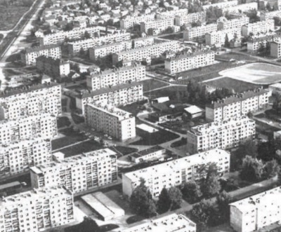
Introduction
Urban recycling of open living spaces
The meaning of the street
Simulation on the multi-apartment neighbourhoods location
Litostroj complex
heavy machinery production, established 1947
Zoning:
industrial,
residential and
recreational zone
Neigbourhood:
school,
kindergarten,
basic services

Slide 4
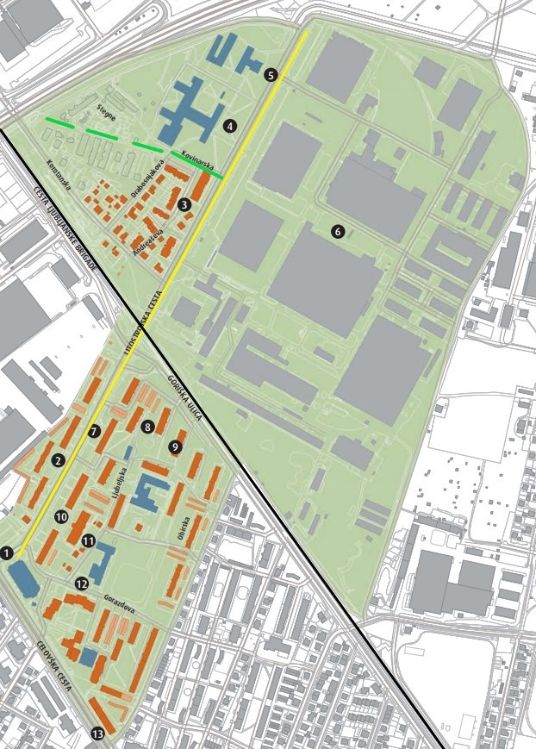
modernistic layout, state-owned socialistic enterprise
Abundance of open spaces
New main avenue
Residential greenary
Recreational park

Slide 5
“… our neighbour was a very skilful man – whatever got broken you could bring to him and he would repear sitting infront of his terraced-house”
“… I remember my grandma living with us and saying that she is not bored while we are all away – she enjoyed sitting at the window and observing people passing-by on the street…”
“… and there were nice flowerbeds in-front of our block of flats …”
“We were playing all around the places, even on the private gardens, they were not fenced at all in those times…”
“… the best place to hang-out was where our and the neighbouring street meet – that is at the end of our street - we were sitting on the fence and could observe what is going on at both streets…”
Litostroj neighbourhood – conversations with the original inhabitants; UIRS: 2012

Slide 6
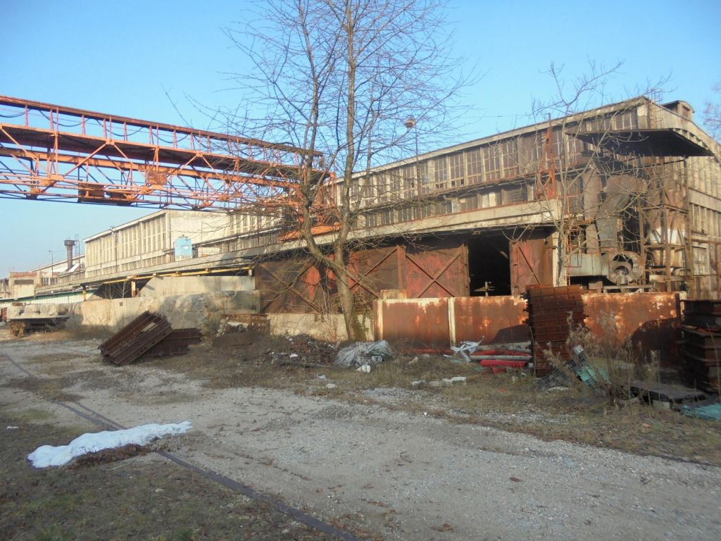
socio-economic changes in 1990s
Collapse of Litostroj
Properties and land on sale
Privatisation of open spaces
Rapid motorisation
Change of demographics in the area (aging up)

Slide 7
Kovinarska ulica / street
ORIGINALLY DESIGNED AS REPRESENTATIVE RESIDENTIAL STREET WITH DISTINCTIVE GREEN STRIPE AT THE ENTRANCE TO WORKERS COLONY
TAKEN CARE OF BY RESIDENTS / APPROPRIATION BY MAINTAINANCE
MOTORISATION
SOLD TO NEW OWNER IN LATE 1990S
PLANS TO BUILD IT UP
TEMPORARY USE FOR HEAVY TRUCKS PARKING

Slide 8
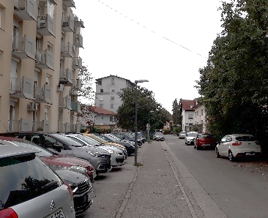
Kovinarska ulica / street
ORIGINALLY DESIGNED AS REPRESENTATIVE RESIDENTIAL STREET WITH DISTINCTIVE GREEN STRIPE AT THE ENTRANCE TO WORKERS COLONY
TAKEN CARE OF BY RESIDENTS / APPROPRIATION BY MAINTAINANCE
MOTORISATION
SOLD TO NEW OWNER IN LATE 1990S
PLANS TO BUILD IT UP
TEMPORARY USE FOR HEAVY TRUCKS PARKING

Slide 9
Kovinarska ulica / street
ORIGINALLY DESIGNED AS REPRESENTATIVE RESIDENTIAL STREET WITH DISTINCTIVE GREEN STRIPE AT THE ENTRANCE TO WORKERS COLONY
TAKEN CARE OF BY RESIDENTS / APPROPRIATION BY MAINTAINANCE
MOTORISATION
SOLD TO NEW OWNER IN LATE 1990S
PLANS TO BUILD IT UP
TEMPORARY USE FOR HEAVY TRUCKS PARKING

Slide 10
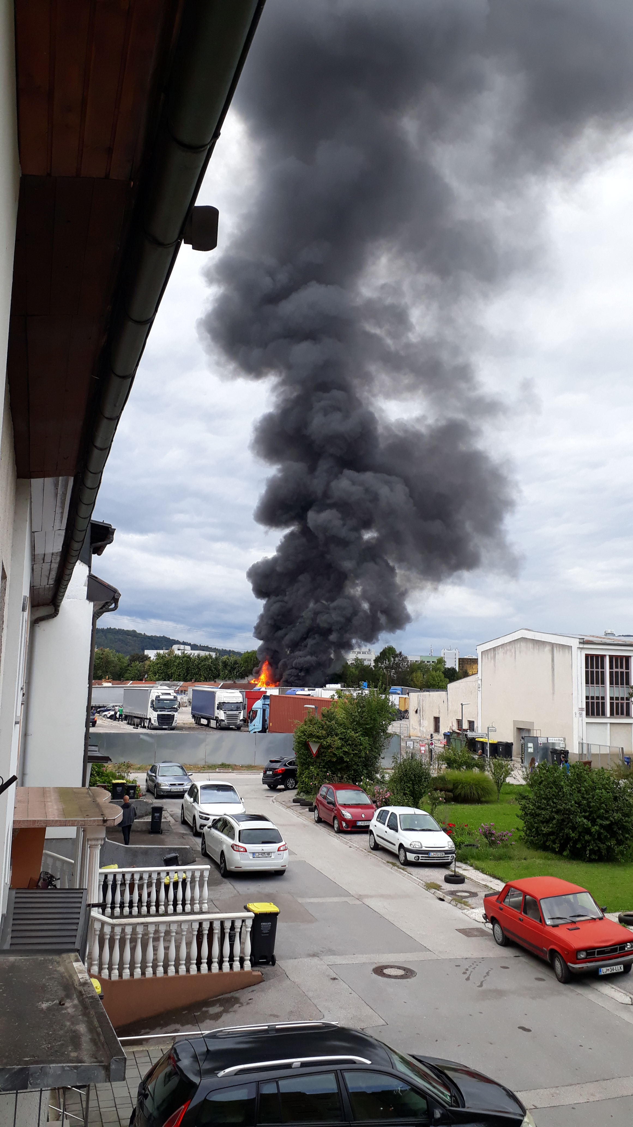
Kovinarska ulica / street
ORIGINALLY DESIGNED AS REPRESENTATIVE RESIDENTIAL STREET WITH DISTINCTIVE GREEN STRIPE AT THE ENTRANCE TO WORKERS COLONY
TAKEN CARE OF BY RESIDENTS / APPROPRIATION BY MAINTAINANCE
MOTORISATION
SOLD TO NEW OWNER IN LATE 1990S
PLANS TO BUILD IT UP
TEMPORARY USE FOR HEAVY TRUCKS PARKING

Slide 11
THERE IS NO NEIGHBOURHOOD WITHOUT NEIGHBOURHOOD’S STREETS FOR ALL!
SUBURBAN AREAS PUBLIC SPACES MANIFESTO NEEDED
1. PUBLIC VS PRIVATE
2. QUALITY OF LIFE VS CAPITAL INVESTMENTS
3. PEDESTRIAN VS CAR
4. THE VOICE OF STRONGEST VS COLOURFUL VOICES

Slide 12
Thank you for your attention!
Matej Nikšič
matej.niksic@uirs.si

