Slide 1
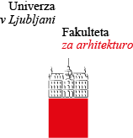
STREETS FOR 2030
PROPOSING STREETS FOR INTEGRATED AND UNIVERSAL MOBILITY
LJUBLJANA 23.&24.9.2020

Slide 2
DINA N. BAROUD, NOTRE DAME UNIVERSITY, LOUAIZE LEBANON
STRIATED AND SMOOTH IDENTITIES: MAPPING TRIPOLI POLITICAL VARIENT INTENSITIES

Slide 3
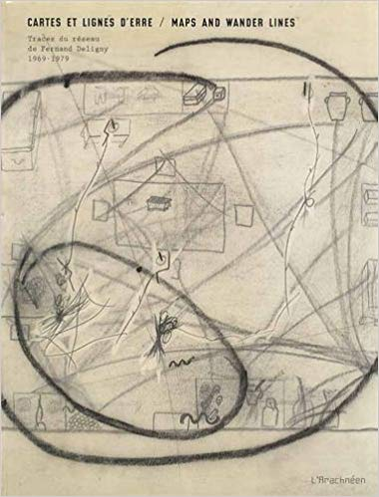
General interest:
The complexity which is inherent in the urban dynamics and reflected in the spatio-temporal reality of urban contexts
Questions:
How urban identities, including political ones,
can be stated where these are the agglomeration
of spatial experiences, memories, places,
spaces as well as strategies and tactics?
How these, and as they change across time
and history, can be represented, mapped and
read? source: google
Fernand DelignyL Lignes d’ettre

Slide 4
Propose: Narration can bring together all elements of such complexity.

Slide 5
Aim conceptualizing a diagrammatic mapping which might illustrate the “dynamic complexity” of narrations that tell stories about changes in political identities

Slide 6
hypothesis:
a cyclic, precisely a spiralling cyclic form, can diagrammatically map the territories across the variant space and time aspects of urban political identities and narrations. The spiral, in this sense, can reflect the political narration’s space and time qualities such as fragmentation, continuity and rhythm
source: google

Slide 7
Case study:
Abdel Halim Karami square, Tripoli, Lebanon, inspecting the political activities between the square’s centre and surrounding spaces and constructions.

Slide 8
Methodology:
Review literature (theoretical frame)
Inspect urban intervention
Map (using drawing tools) findings
Propose possible analysis

Slide 9
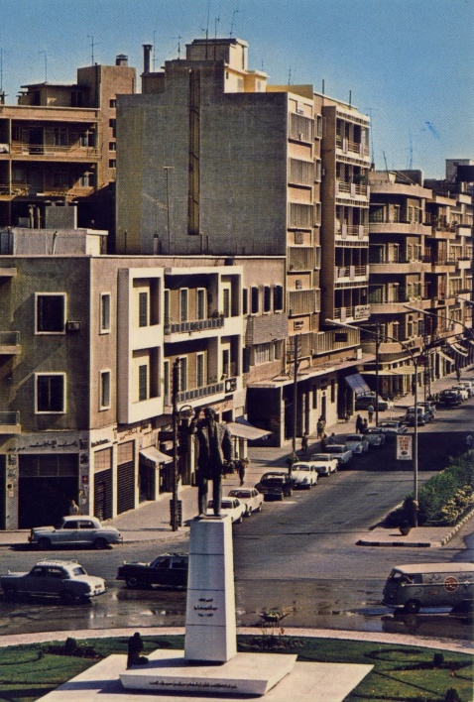
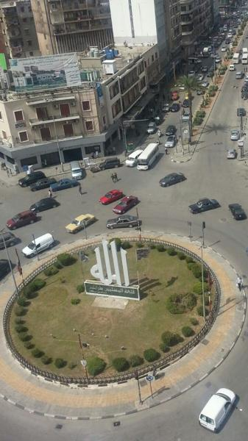
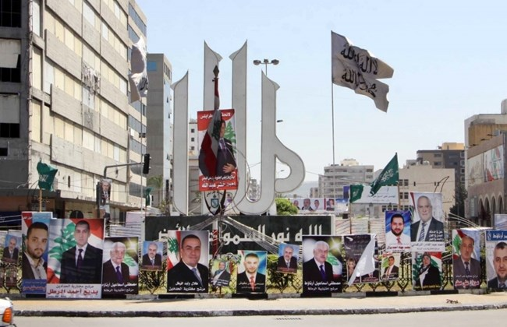
Karami Square: political events:
before 1976 after 1976 recent political protests
source: google

Slide 10
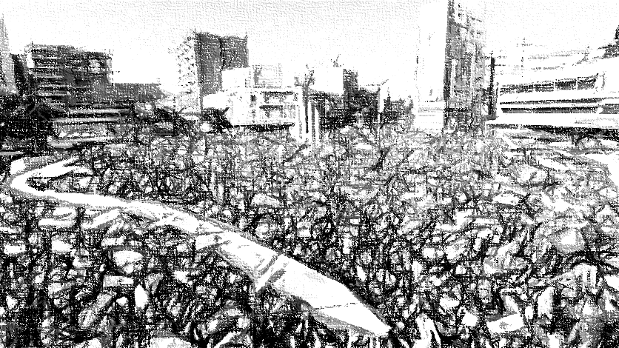
October 17, 2019 protests

Slide 11
Theoretical propositions to read the changing political identity of the area (center periphery relation)
Michel de Certeau: narration’s circumstances are restructured in a new logic and identity—that of the fictional space—where time and space follow new inter-relationship of compactness and extension… “It recalls still more the mathematic theme of an identity correspondence between a circle and its centre.”

Slide 12
Theoretical propositions to read the changing political identity of the area (center periphery relation)
2. Bruno Latour: `’[e]lements that appear remote if we follow the spiral may turn to be quite nearby if we compare loops.” (Latour, 1993). Hence, the spiral constructs a physical existing entity: its looping line; and its open negative space: that which stretches between its loops. By this, the spiral is susceptible to map along its line what is determined and in its open space what is vibrant and indefinite.

Slide 13
Theoretical propositions to read the changing political identity of the area (center periphery relation)
3. Gilles Deleuze and Flèx Guattari (What to map): the striated space is a determined territory which is defined by metric lines that join points. The smooth space, on the other hand, is rather a territory that is constantly being defined by lines or vectors that are not metric but directional.

Slide 14
In such spaces, the circumstances and experiences of narration as follows: striated space—the spiral’s looping line—can represent the narrations realistic context; the smooth space—the spiral’s open negative space in between the loops—can represent the unending experiences and de-territorization/reshaping of the story; precisely evidences (interventions during political activities).

Slide 15
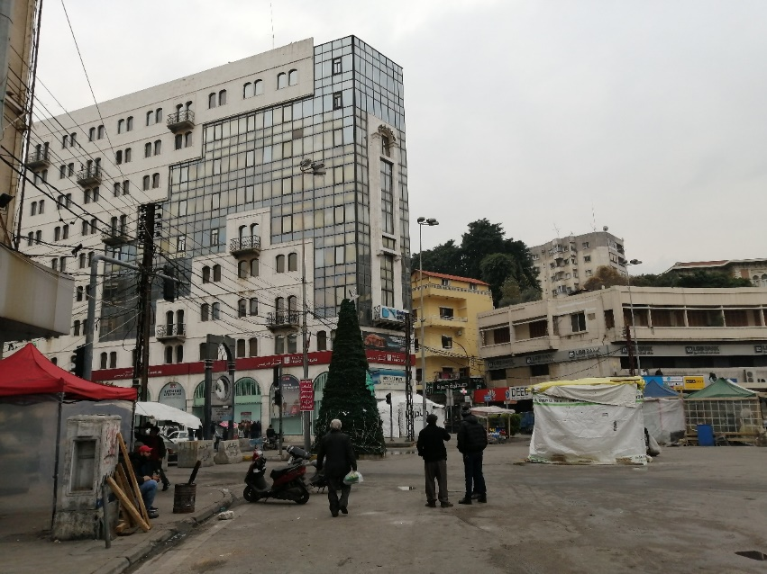
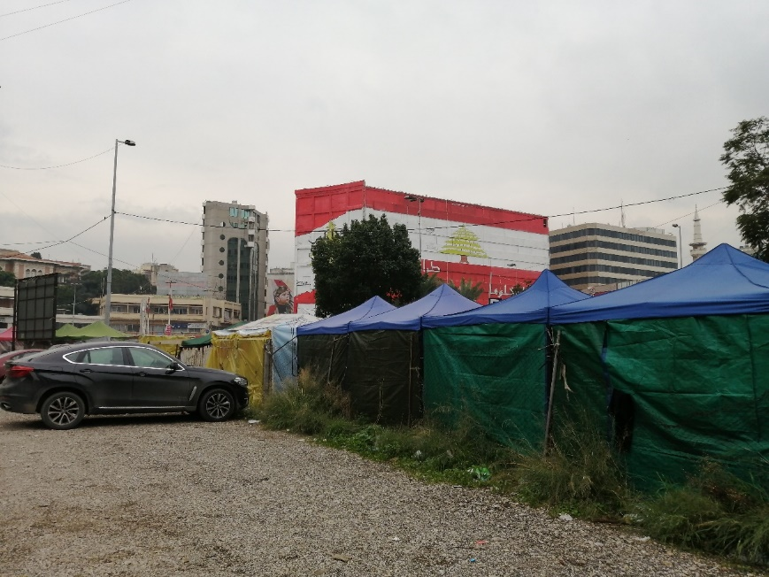
Mapping attempts:
Investigating tents

Slide 16
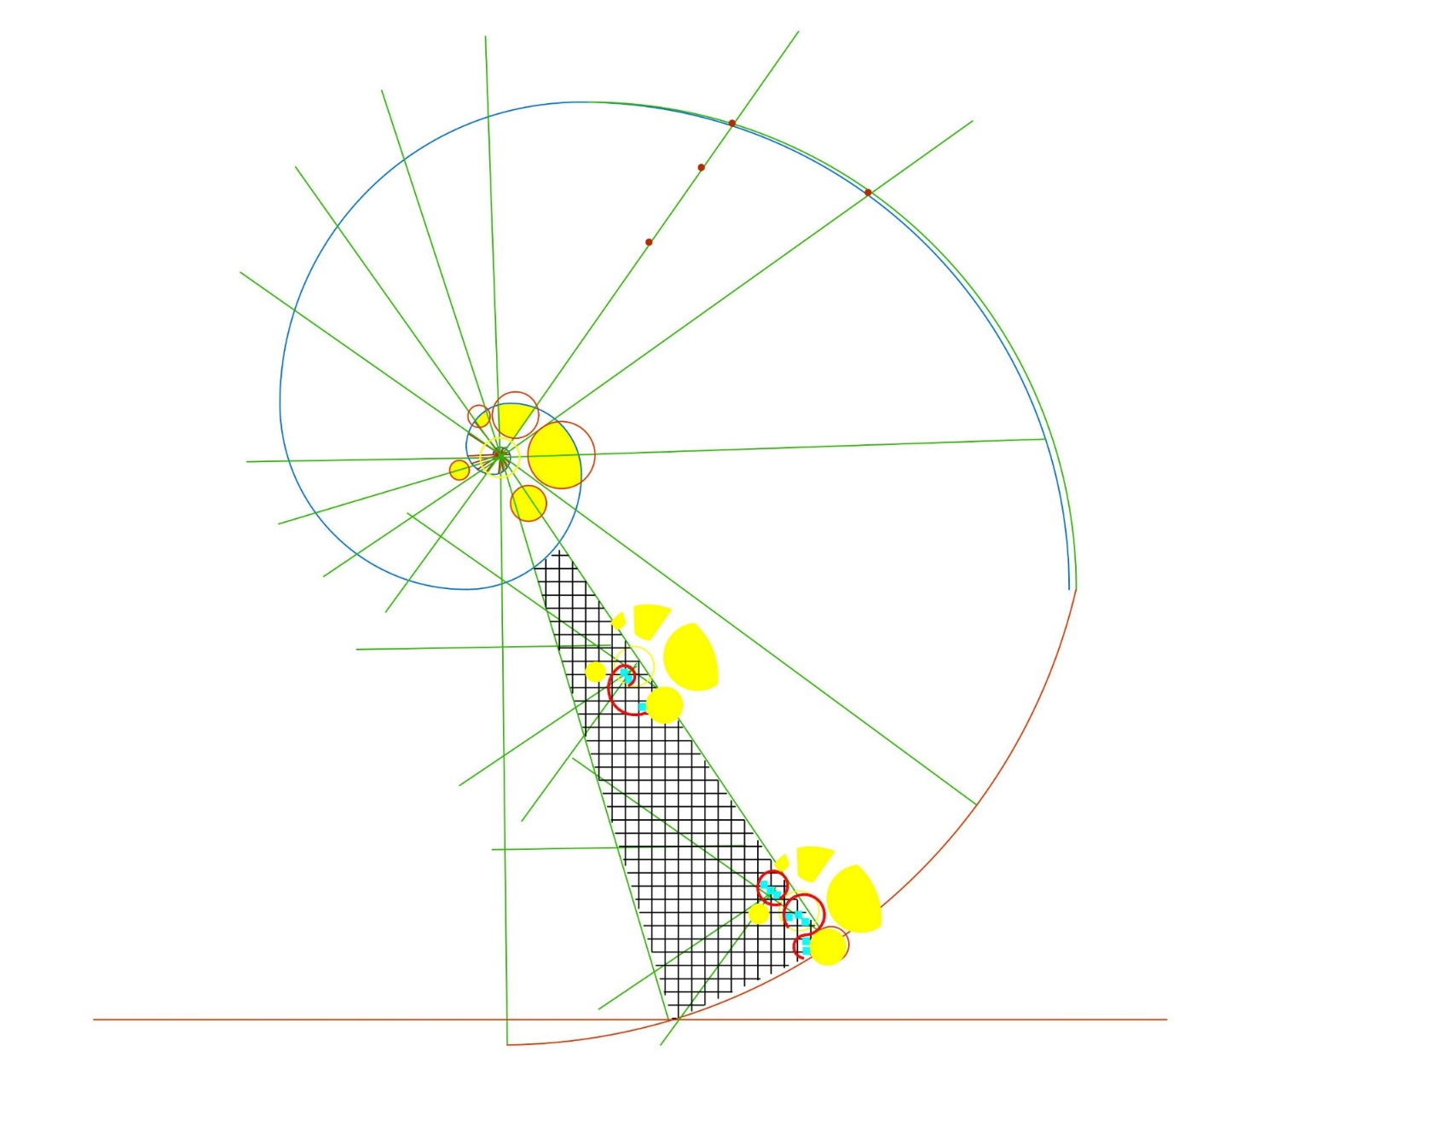
Mapping attempts:

Slide 17
Mapping attempts:

Slide 18
Conclusion
diagram could indicate political intensities and their flow. By analysing and comparing the spatial distribution of tents across the loops, what could be defined are indicators that can characterize the political fields of intensities at the place.
-these indicators and characteristics can be subjected to rhythmanalysis, or the question of continuity and discontinuity between the striated elements in the diagram and the smooth distribution (of tents) in-between the spiral loops: The historic projection across the loops, (to map the political changing rate) the tension and proximity between the striated and the smooth experiences and distribution of events and imagination (to map the intensity of struggle an protest between demonstrators and authority), the changing pattern and flow between both spaces and across time (to map persistence and strategies of the political activities), and, finally, the scale of presence of the interventions/tents (to map tactics of interventions and imagination, provision and prospects of the activists).

Slide 19
task: to develop a more elaborate spiral diagram which can encompass diverse and more complex layers and levels of the spatial and temporal political situations and, materialistically, to develop what could be the evidences for spatial inter-relation between the striated and the smooth space.

Slide 20
References
Stockmans, J. and K. Buscher (2017). A spatial reading of urban political-religious conflict: contested urban landscapes in Addis Ababa, Ethiopia. J. of Modern African Studies, 55(1), 79-104.
Tianchen Dai, T. Zhuang, J. Yan and T. Zhang (2018). From Landscape to Mindscape: Spatial Narration of Touristic Amsterdam. Sustainability, 10 (2623).
Verraest, S. and B. Keunen (2012). Introduction to New Work on Landscape and Its Narration. CLCWeb: Comparative Literature and Culture, 14 (3).
Fişek, E. (2018). Palimpsests of Violence: Urban Dispossession and Political
Theatre in Istanbul. Comparative Drama, 52 (3), 349-371.
Chirobocea, O. (2017). Perspectives on the Relation between History and Fiction. Philologica Jassyensia, 2 (26), 191–202.
George Rossolatos, G. (2018). Post-place branding as nomadic experiencing
Place Brand Public. Dipl, 14, 285–304.
Gadinger, F., Ochoa, C. S. and Yildiz, T. (2019). Resistance or Thuggery? Political Narratives of Urban Riots. NARRATIVE CULTURE, 6 (1), 88–111.
Deleuze, G. and F. Gauttari (1987). A Thousand Plateaus: Capitalism and Schizophrenia. Continuum.
(de) Certeau, M. (1984). The practice of everyday Life. University of California Press.
Latour, B. (1993). We have never been modern. Harvard University Press.
Brighenti, A. M. and Kärrholm, M. (2018). Beyond rhythmanalysis: towards a territoriology of rhythms and melodies in everyday spatial activities. City Territ Archit, 5(4).
Morton, T. (2013). Hyperobjects: Philosophy and Ecology after the End of the World. University of Minneapolis Pre

Slide 21
Thank you

