Slide 1
STREETS FOR 2030
PROPOSING STREETS FOR INTEGRATED AND UNIVERSAL MOBILITY
LJUBLJANA 23.&24.9.2020

Slide 2
Višnja Kukoč
Assis. Prof. Dr, University of Split, Faculty of Civil Engineering, Architecture and Geodesy
Mirza Džananović
Assis. Prof. Dr, University of Zenica, Faculty of Philosophy
Marko Borota
MA, Independent designer
Jelena Borota
M. Arch, GISplan
Mariana Bucat
M Arch, Arhitektonski Kolektiv
DYNAMIC STREETS AND CITY ROGRAMS

Slide 3
Streets are the primary urban element and the primary public good.
In regard to programs there is a primary street with city programs, a business street with a variety of businesses, a housing street with housing programs and a combination of all three.
In regard to purposes there are streets to pedestrians and streets to automobiles.

Slide 4
We researched how city programs influence dynamism of streets, not exposed to tourism?
Relevant insight of the topic similar to ours we find in the book of Jan Gehl and Lars Gemzøe Public spaces_ Public Life first published in 1996.

Slide 5
Researchers today are preoccupied with reclaiming city streets for people, shared space and pedestrian safety. Pedestrianisation is seen as a great necessity

Slide 6
But already in 1960s it was obvious: “The onslaught of cars and the pressure of that industry, that is, the lobbies for cars have made the crumb the main object, the parking lot an obsession, the traffic the primary goal, the destroyers of every social and urban life. The day is approaching when the rights and powers of the car will have to be limited, not without difficulties and damage” Lefebvre (1974).

Slide 7
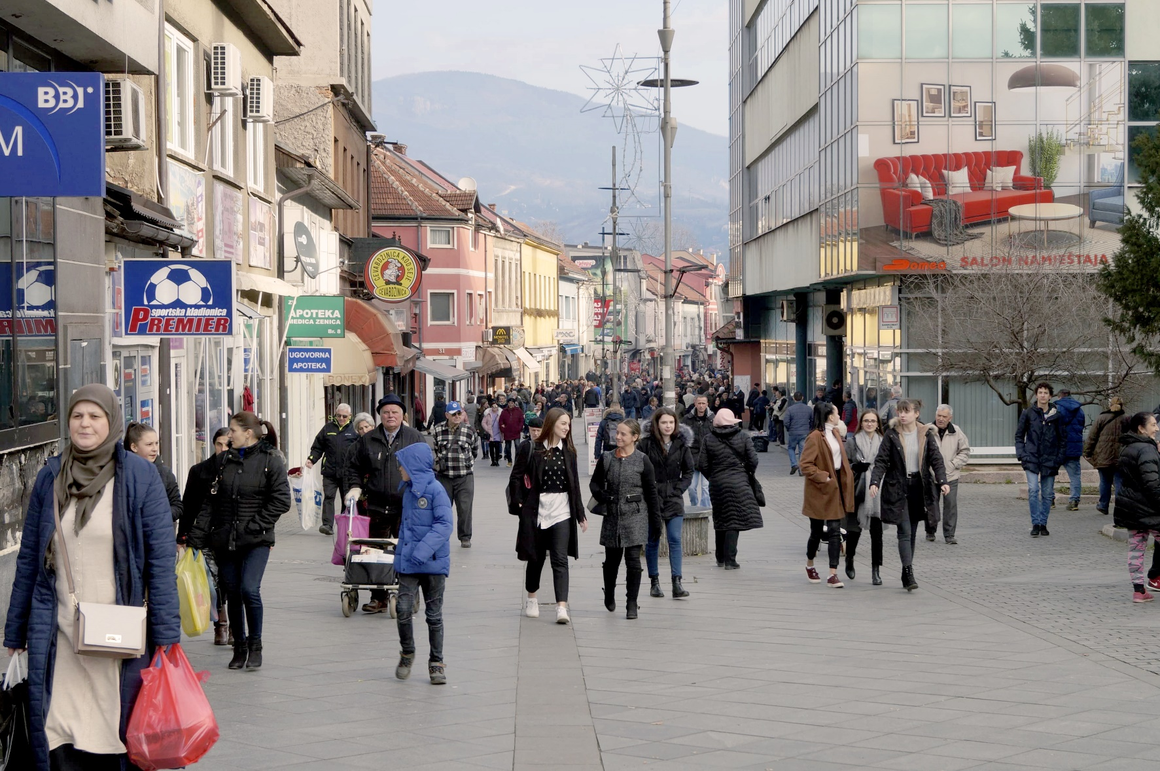
Maršala Tita Street in Zenica, in BiH, is the first street we analysed.

Slide 8
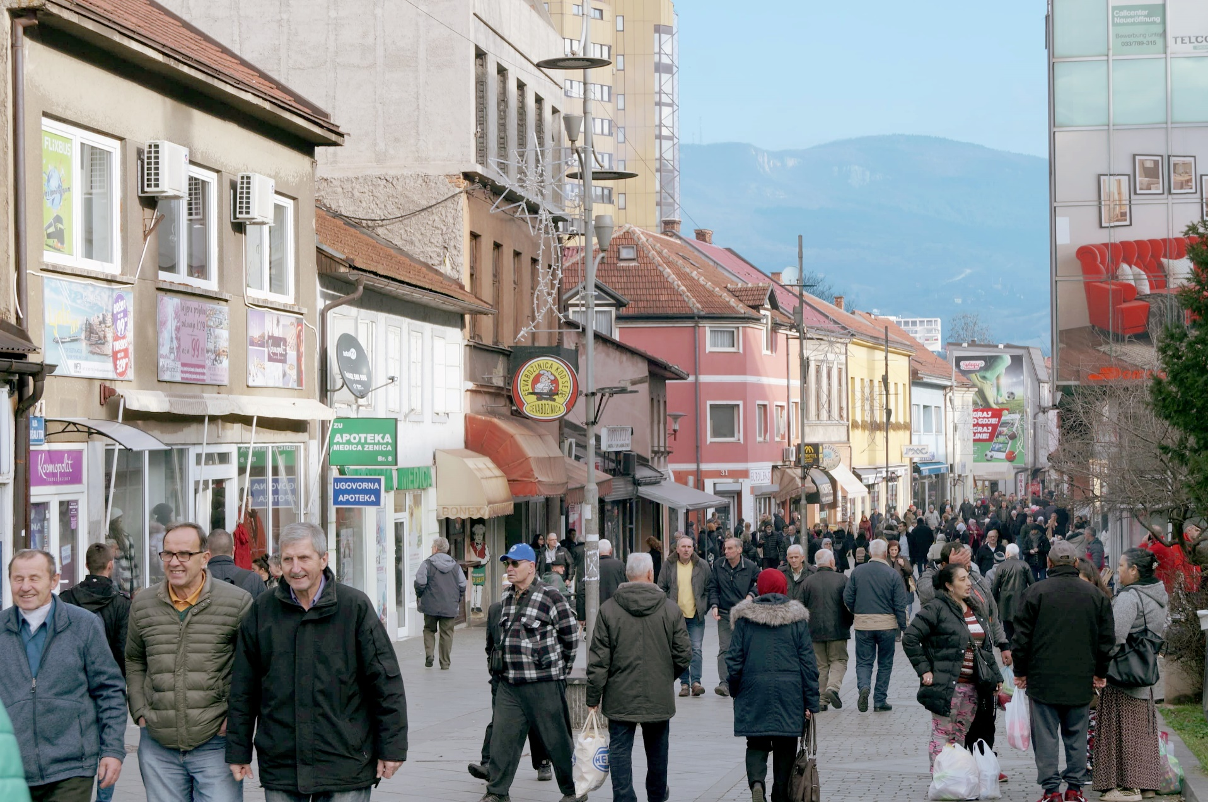

Slide 9
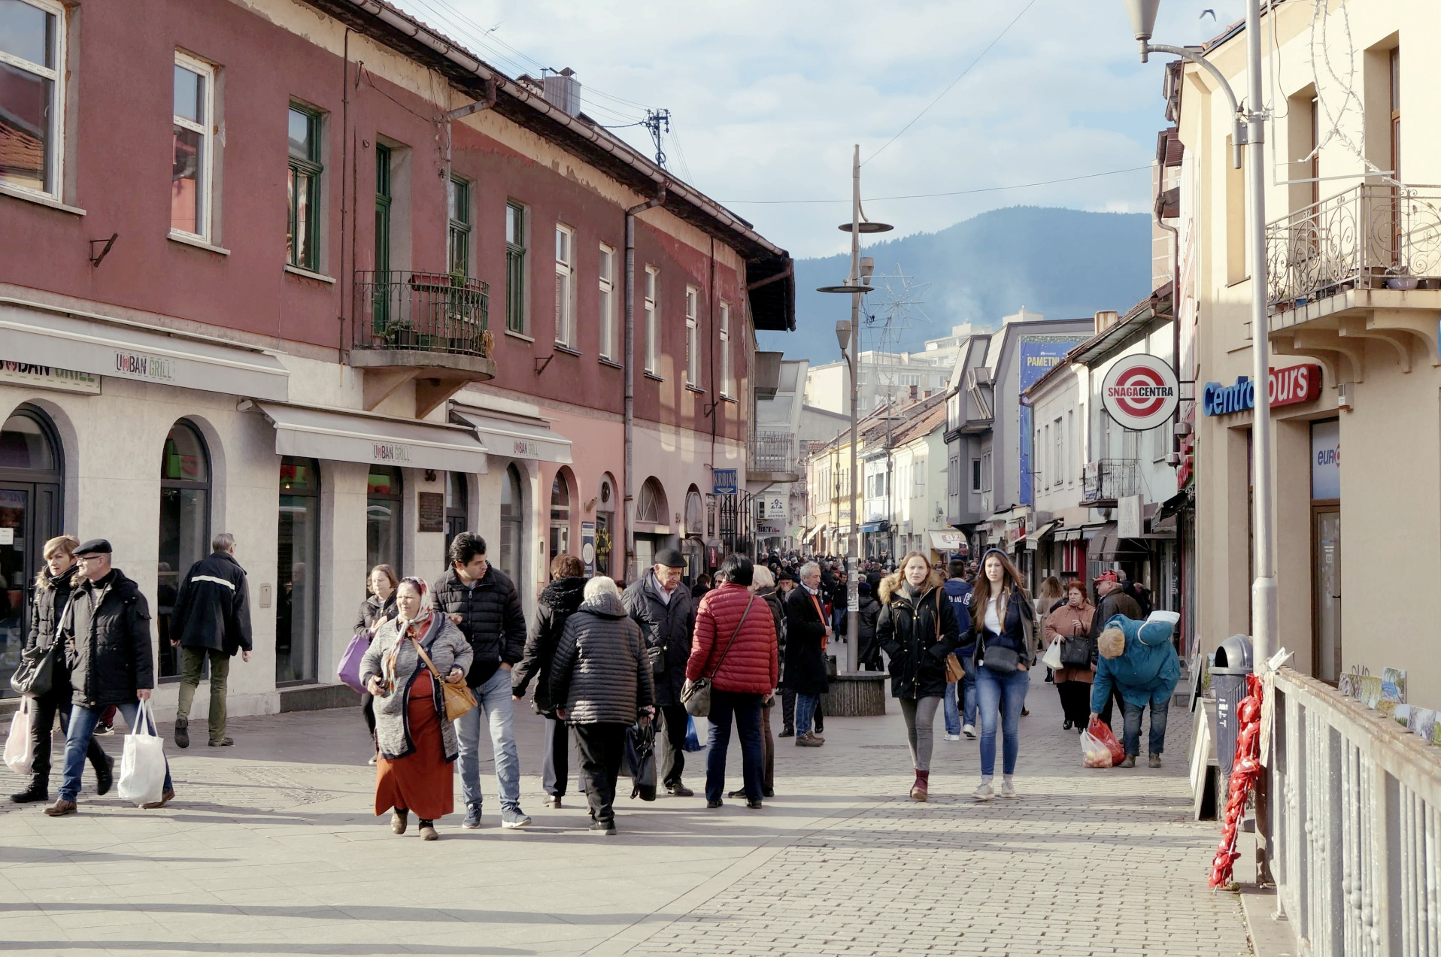

Slide 10
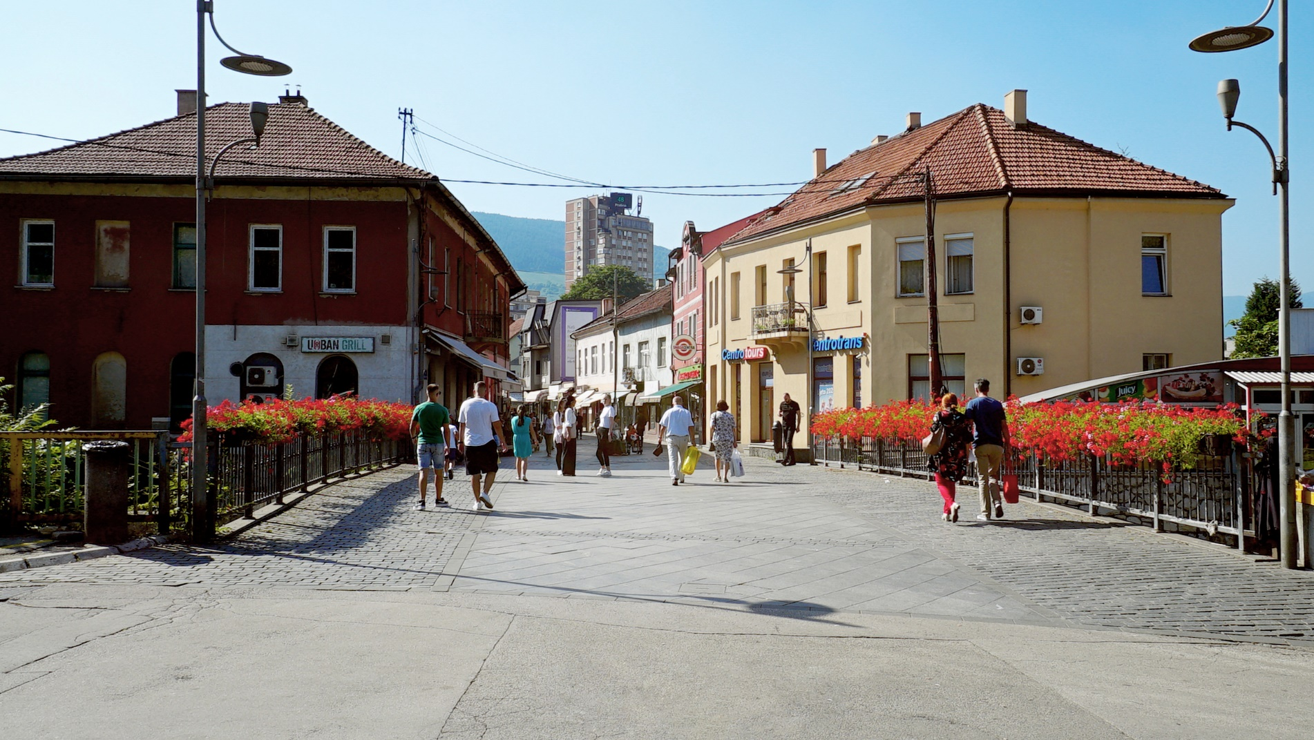

Slide 11
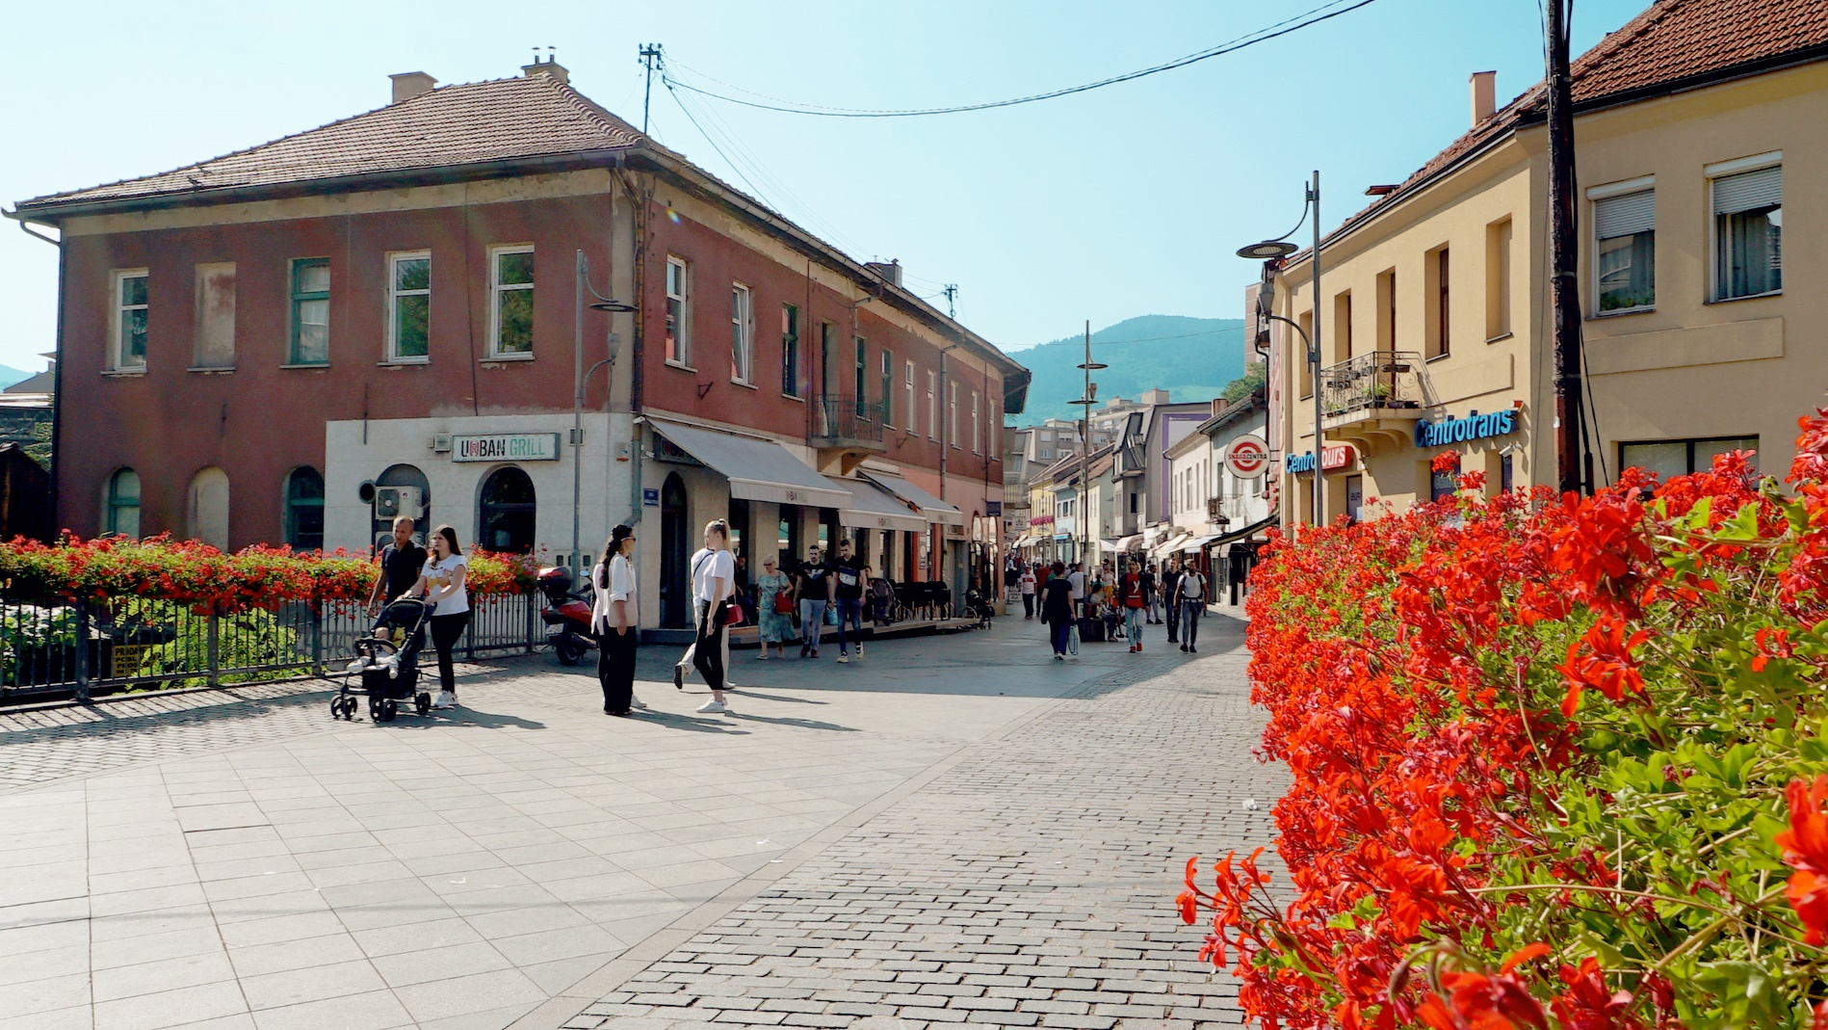

Slide 12
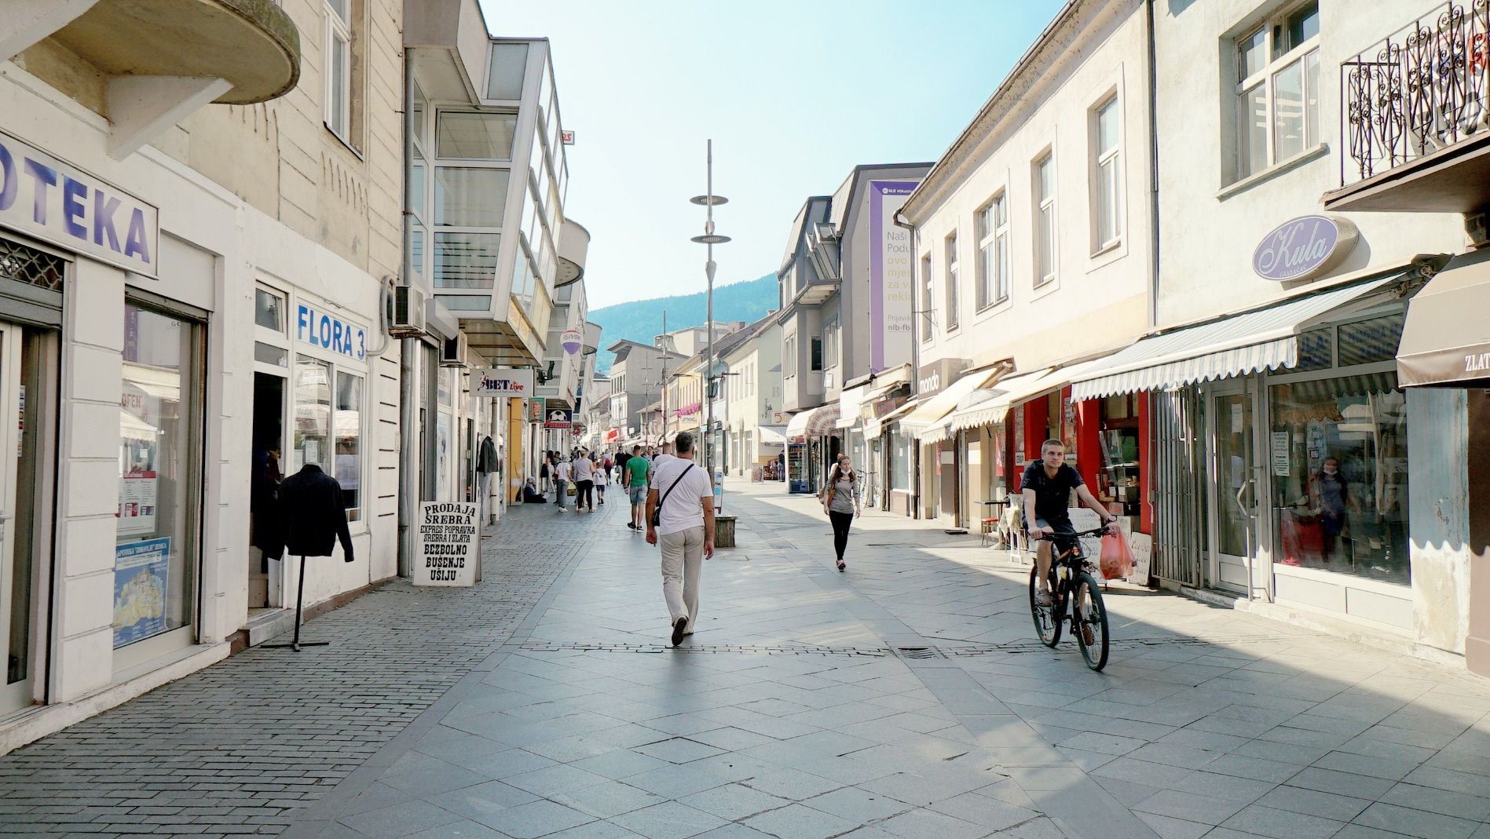

Slide 13
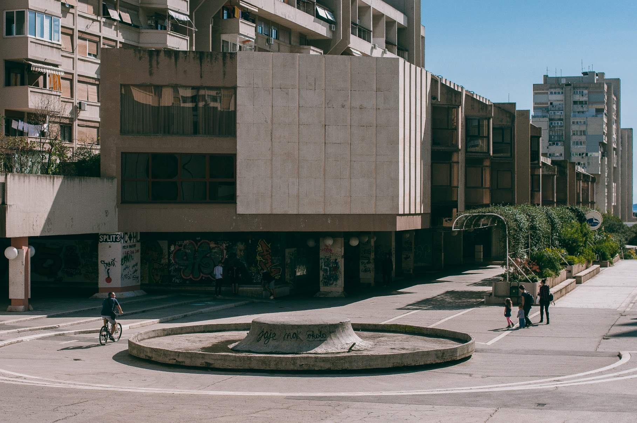
Ruđera Boškovića Street in Split/Split 3, in Croatia, is the second street we analysed.

Slide 14
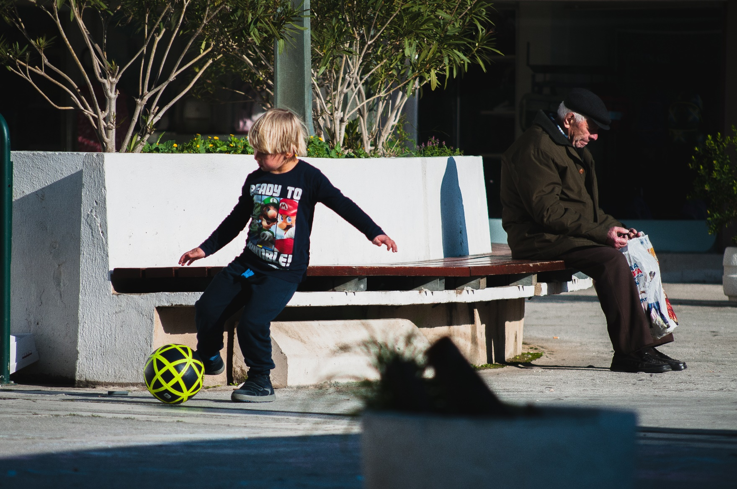
„Residents contribute to the vitality of the city at all times of the day and night, going about their daily tasks „ Gehl, Gamzøe (2004).

Slide 15
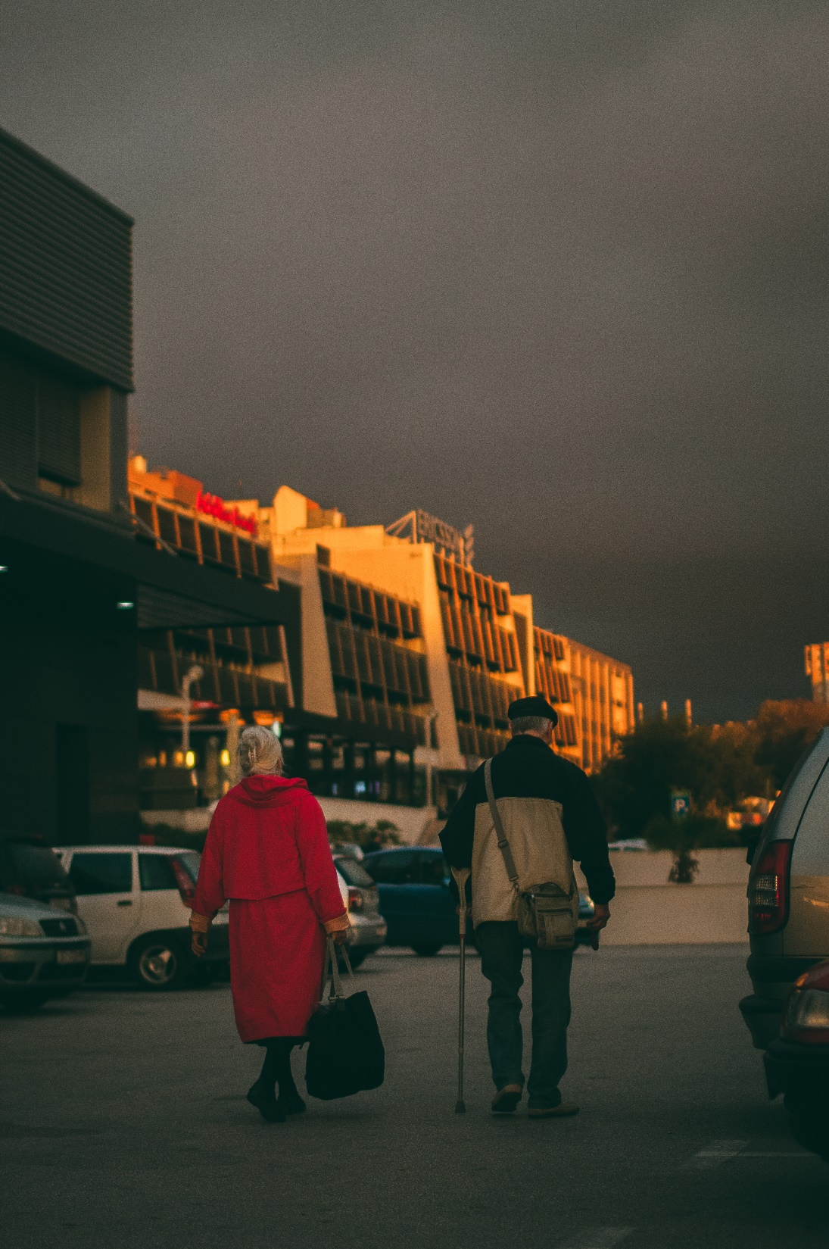

Slide 16
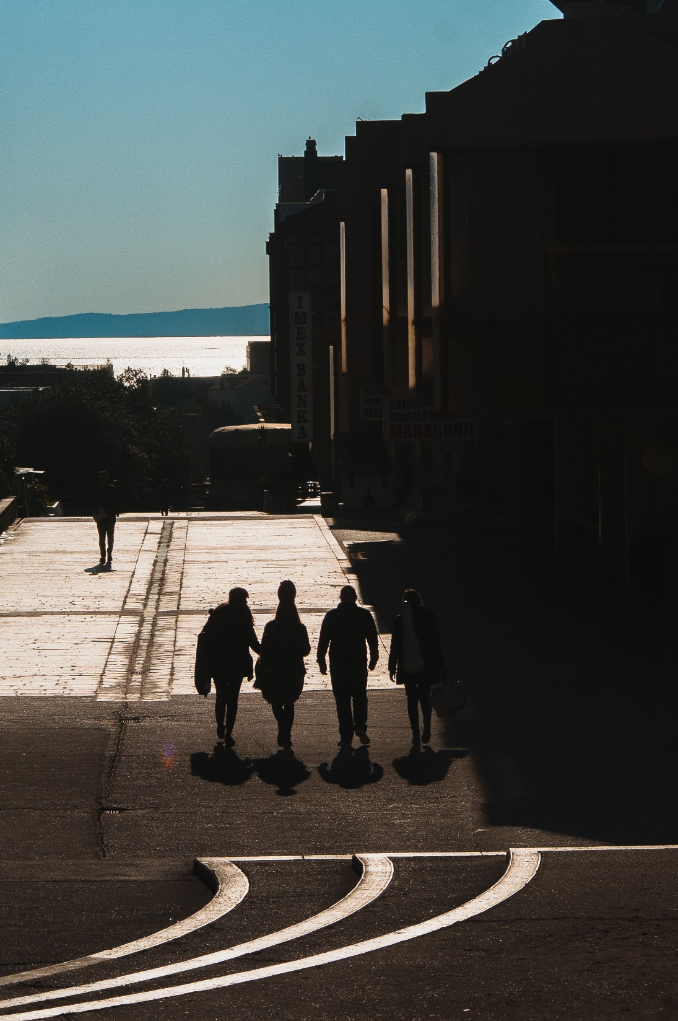

Slide 17
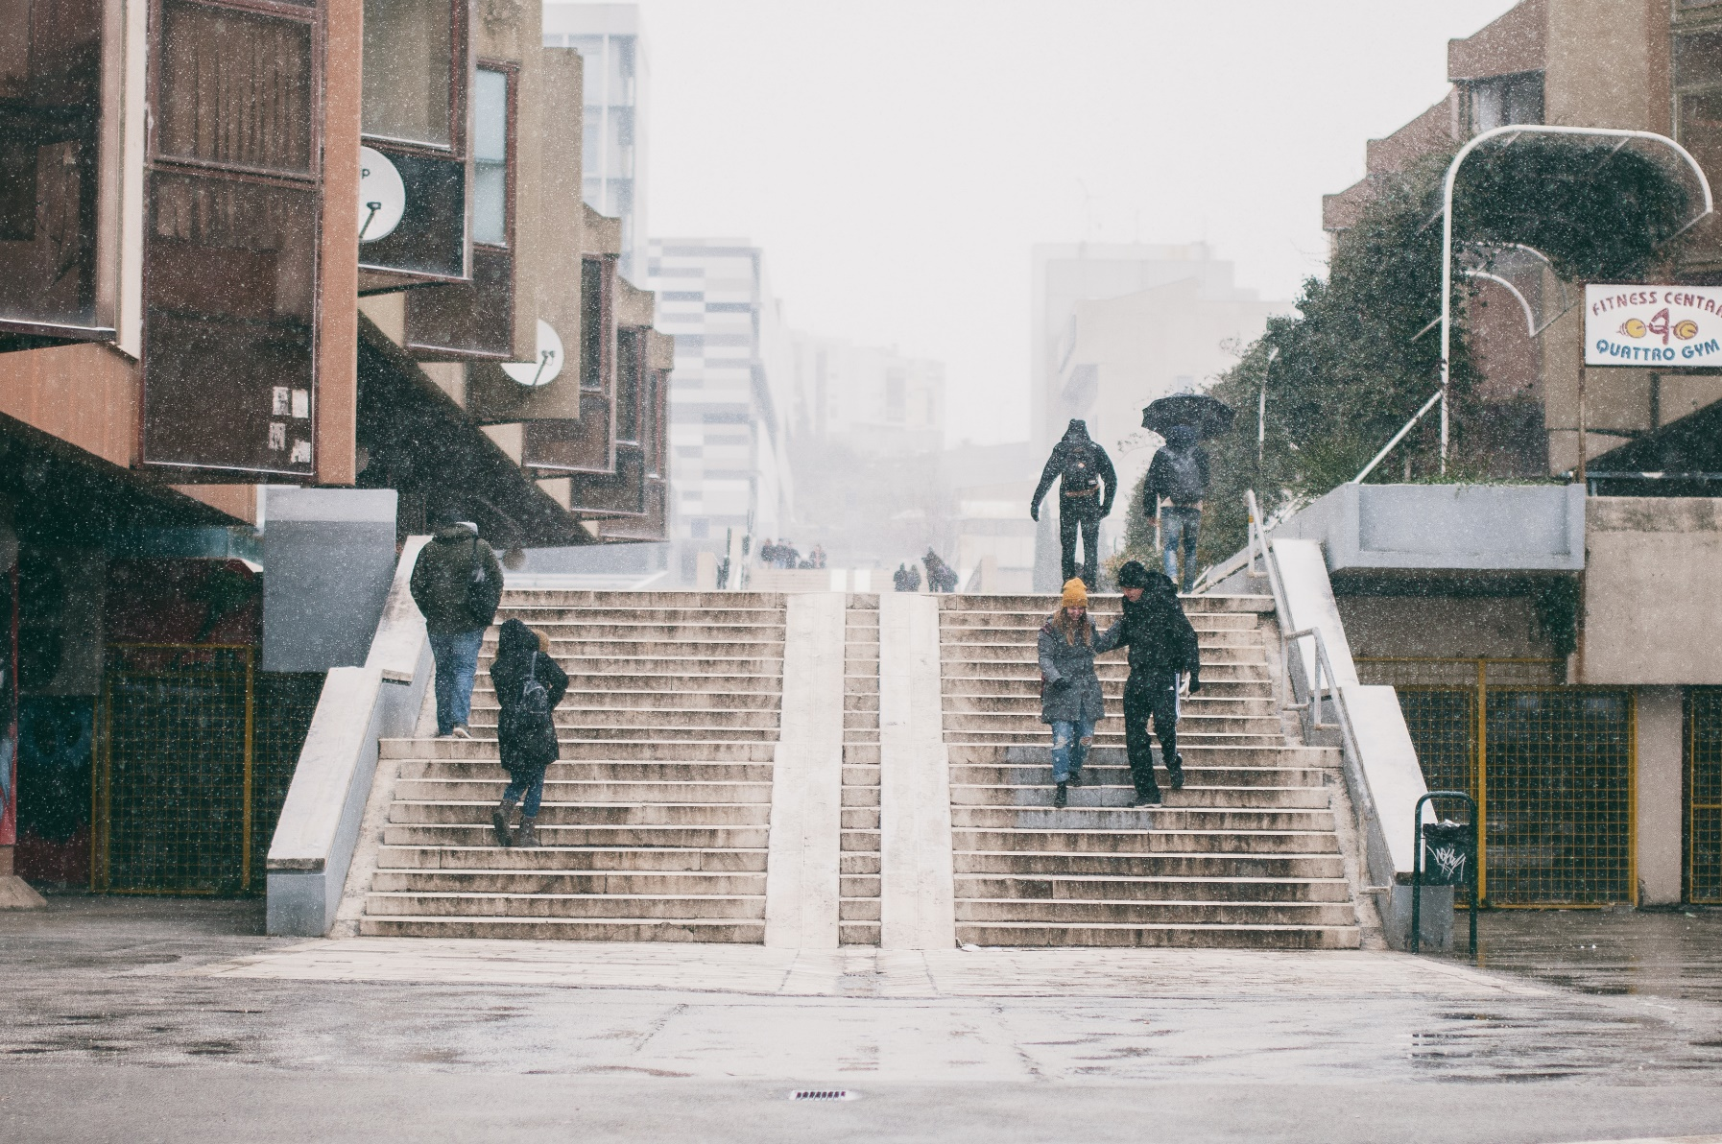
„No single factor has more influence on the vitality of city centres than the presence of universities and students in the area” Gehl, Gamzøe (2004).

Slide 18
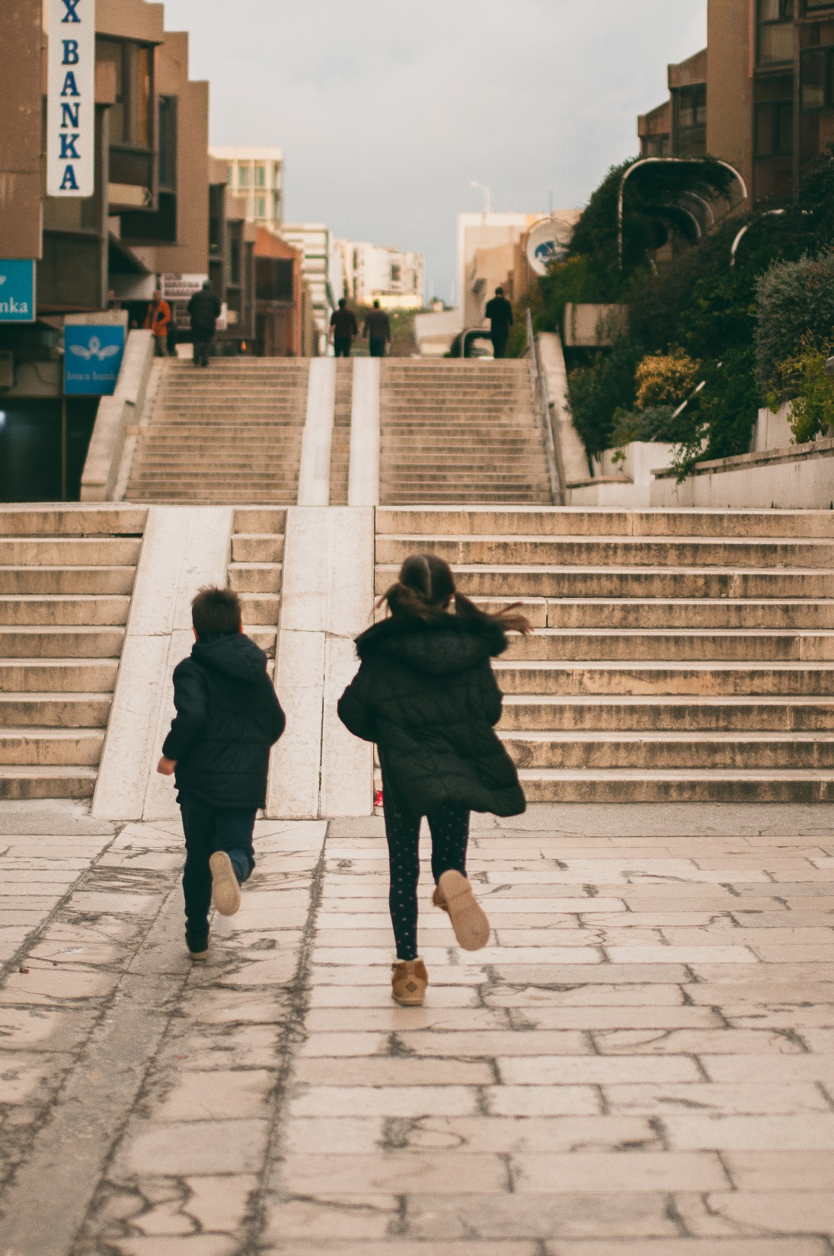

Slide 19
Simultaneous count of passers-by at different times of the day and of the month, listing of programs of the streets, and comparison of the outcome obtained in the two streets was interrupted by restriction of movement that occurred due to the pandemic caused by COVID -19.
Results, of only a third of the planned survey we present as preliminary.

Slide 20
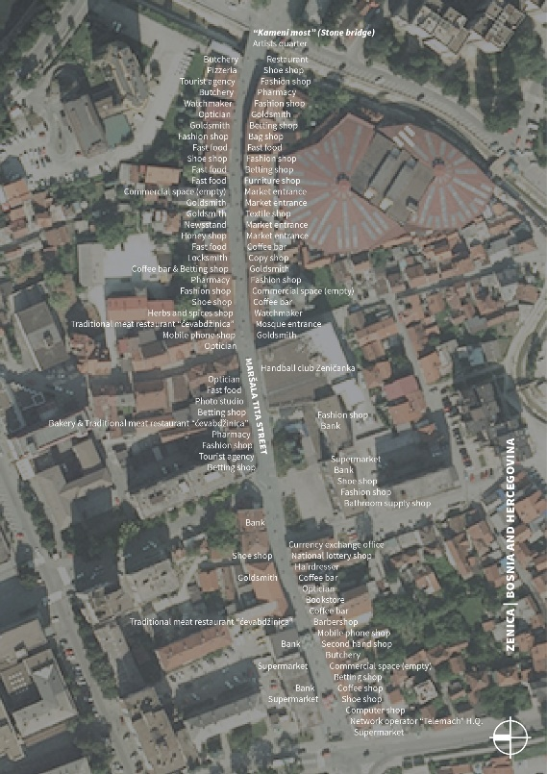
Maršala Tita Street with all programs and services (Orto-photo: GISplan archive)

Slide 21
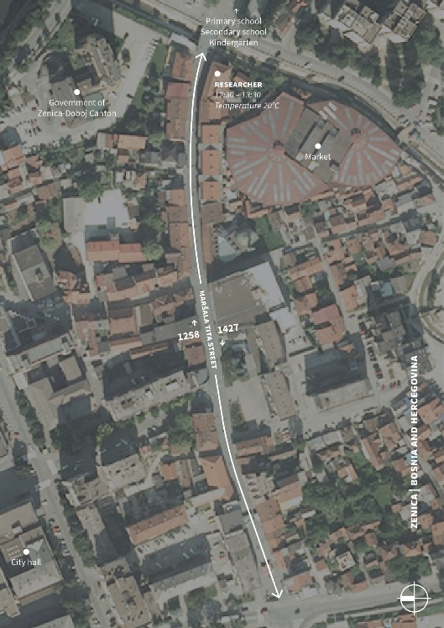
The first count of pedestrians on Maršala Tita Street (Orto-photo: GISplan archive)

Slide 22
The second count of pedestrians on Maršala Tita Street (Orto-photo: GISplan archive)

Slide 23
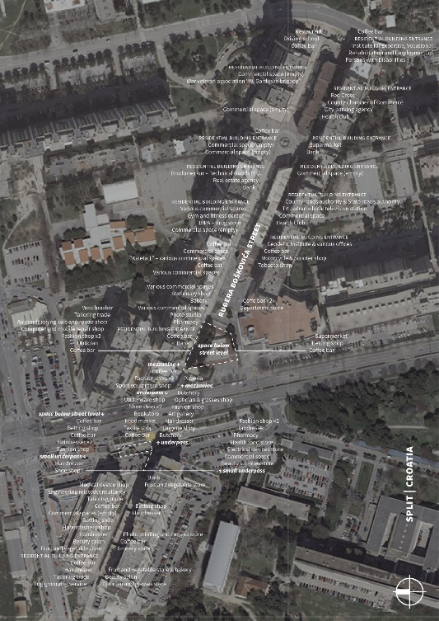
Ruđera Boškovića Street with all programs and services (Orto-photo: GISplan archive)

Slide 24
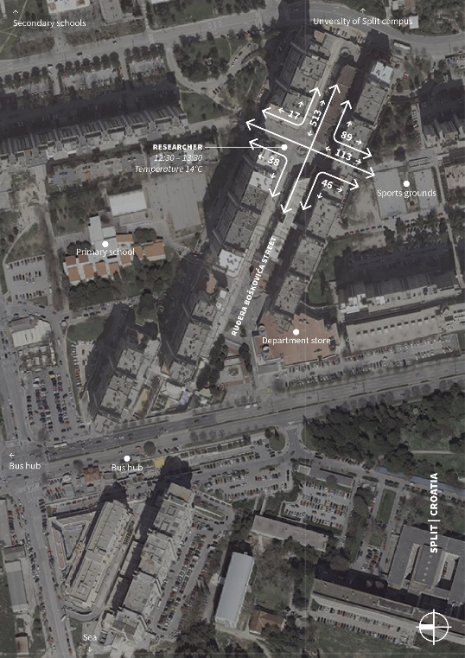
The first count of pedestrians on Ruđera Boškovića Street (Orto-photo: GISplan archive)

Slide 25
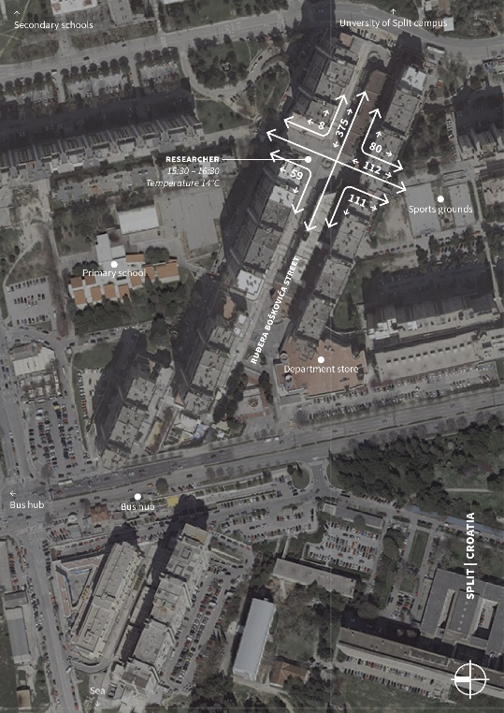
The second count of pedestrians on Ruđera Boškovića Street (Orto-photo: GISplan archive)

Slide 26
Conclusion:
Diversity and mixture of uses are preconditions of dynamic streets. This includes both, the dense concentration in the case of people who are there because of residence and those who are there because of city programs, on the very street or in the vicinity.

Slide 27
Reflections and recomendation
The actual contribution to the set thesis would be fully realized through the continuation of research in the following months. Maršala Tita Street in Zenica, in BiH and Ruđera Boškovića Street in Split/Split 3, in Croatia, are both vital to city life. To describe their qualities and special features will give an overview of their strengths and uniqueness to everyone concerned with urban development – users, owners, merchants and politicians.

Slide 28
References
Džananović, M. (2017). Grad u dimnjacima – urbanizacija Zenice od 1945. do 1990. godine (City in chimneys - urbanization of Zenica from 1945 to 1990), Udruženje za zaštitu intelektualnih i kulturnih vrijednosti Zjenica.
Gehl, J., Gemzøe, L. (2004). (First published in 1996) Public Spaces Public Life – Copenhagen, The Danish Architectural Presss & The Royal Danish Academy of Fine Arts. School of Architecture Publishers.
Jacobs, J. (1992). (First published in 1961) The Death and Life of Great American Cities. Vintage Books.
Kukoč, V. (2013). Metoda za načrtovanje javnih mestnih prostorov v obdobju tranzicije na primeru Split III (Method of Planning of Urban Public Places in Times of Transition as Exemplified by Split III). Theses, University of Ljubljana.
Lefebvre, H. (1974). (First published in 1970) Urbana revolucija (The original title: La révolution urbaine). Nolit.
Mušič, V. B. (1970). Urban Design and Development of the Split 3 Project, SINTEZA –journal of art culture, double issue 18 & 19.

Slide 29
Official pages of the Assembly and the Government of Zenica - Doboj Canton, B&H. (2020, June 9). Trade, tourism and catering. Retrieved from https://zdk.ba/press/item/2965-trgovina-turizam-i-ugostiteljstvo
The Economist (2020, May 14). Has covid – 19 killed globalisation? Retrieved from https://www.economist.com/leaders/2020/05/14/has-covid-19-killed-globalisation
Photography:
Zenica: Džananović M. and Albaldawi A.
Split: Jurčić L.

