Slide 1



STREETS FOR 2030
PROPOSING STREETS FOR INTEGRATED AND UNIVERSAL MOBILITY
LJUBLJANA 23.&24.9.2020

Slide 2
Presenter:
Katarina Rus
University of Ljubljana, Ljubljana SI-1000, Slovenia, katarina.rus@fa.uni-lj.si
Coauthors:
Prof. Dr. Vojko Kilar
Asst. Prof. Dr. David Koren
CONFIGURATION OF A CITY STREET NETWORK TO SUPPORT URBAN SEISMIC RESILIENCE

Slide 3
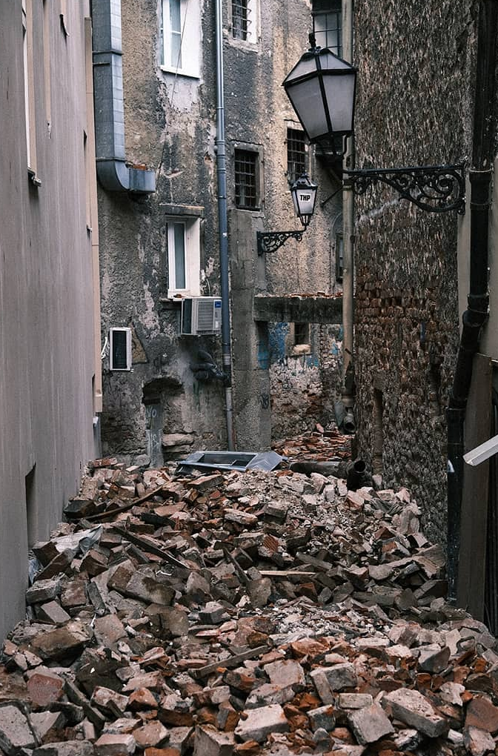
URBAN SEISMIC RESILIENCE
A resilient urban system is a sustainable network of physical systems (buildings, infrastructure and open spaces) and a social community capable of managing extreme events. It is able to maintain its basic operation during a disaster and following it the original functionality is restored, while relationships and interactions between individual components (buildings, the street network, open spaces and the social community) and their elements may also have changed.
Zagreb 2020, Photo: L. Tambača

Slide 4
STREET NETWORK PROPERTIES OF A SEISMICALLY RESILIENT CITY
STREET DESIGN
Width depends on the aspect ratio, type and purpose of transportation infrastructure. The degree of street disturbance is defined by the impact radius of each building adjacent to the street.
Edge design can create permeability and connectivity between indoor and outdoor spaces.
Layout and orientation (direction of the street axis) are mainly related to energy and climate resilience of cities.
Argyroudis et al., 2015

Slide 5
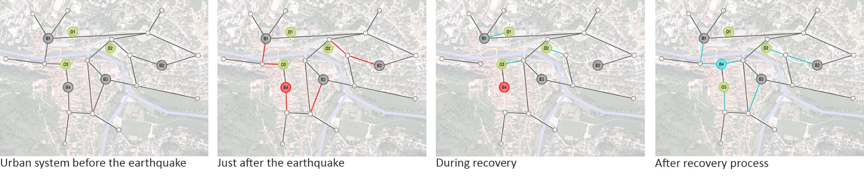
STREET NETWORK PROPERTIES OF A SEISMICALLY RESILIENT CITY
STREET NETWORK TOPOLOGY
Graph theory - The road network can be translated into a mathematical graph constructed of points representing intersections and links between them representing individual road and street segments.
Centrality - the degree of importance
Connectivity - redundant connections that provide alternative options in the event of an element failure
Accessibility - the distance of individual elements of the system to each other, which is also known as system performance

Slide 6
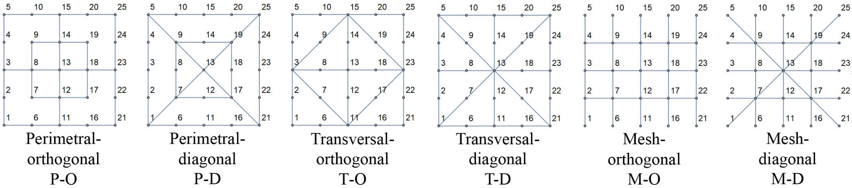
A PRELIMINARY ANALYSIS OF THE STREET SYSTEM TOPOLOGY AND ITS IMPACT ON URBAN RESILIENCE
The purpose of this study was to test different measures and algorithms of graph theory in order to supplement the global efficiency measure for the seismic resilience assessment of an urban system.

Slide 7
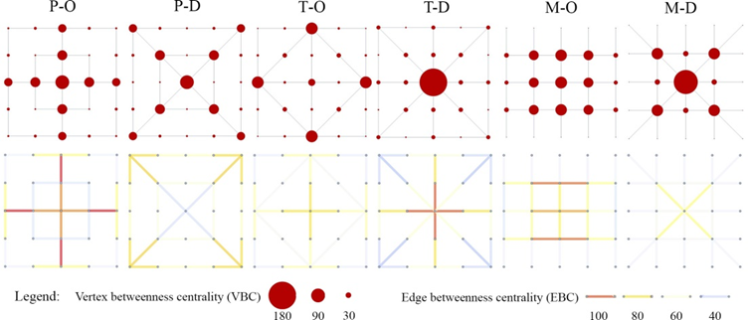
CENTRALITY MEASURES
BETWEENNESS CENTRALITY

Slide 8
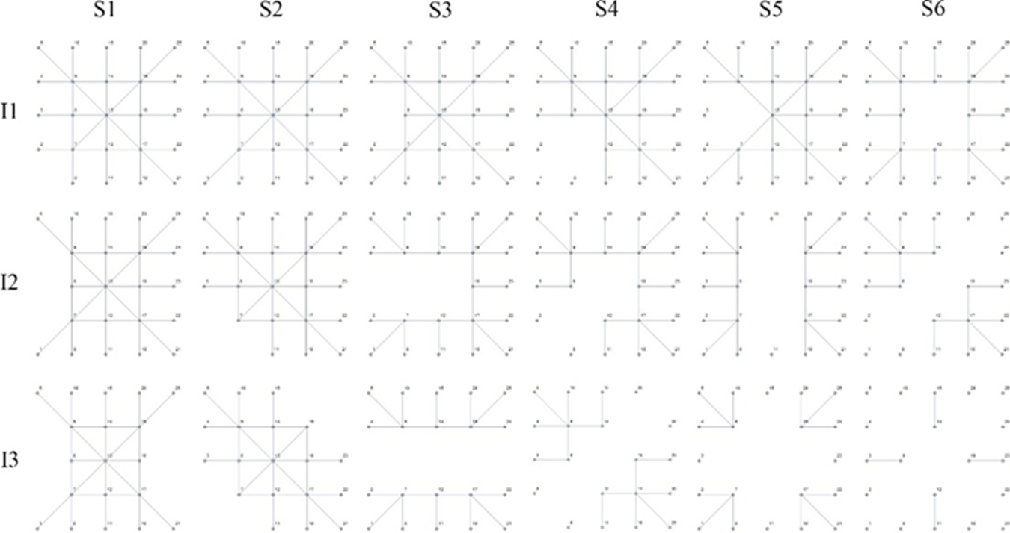
SEISMIC SCENARIOS AND INTENSITIES
A graphically presented M-D street network, which is affected by 6 different seismic scenarios at 3 different intensities.

Slide 9
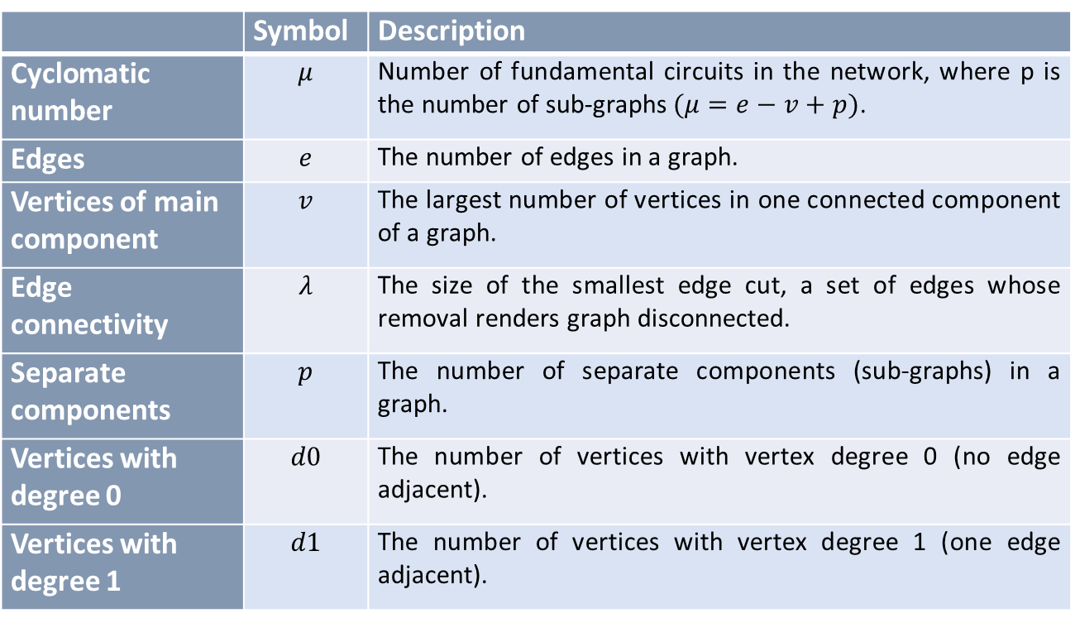
CONNECTIVITY AND ACCESIBILITY MEASURES
 | Symbol | Description
Cyclomatic number | $$μ$$ | Number of fundamental circuits in the network, where p is the number of sub-graphs$(μ=e−v+p)$.
Edges | $$e$$ | The number of edges in a graph.
Vertices of main component | $$v$$ | The largest number of vertices in one connected component of a graph.
Edge connectivity | $$λ$$ | The size of the smallest edge cut, a set of edges whose removal renders graph disconnected.
Separate components | $$p$$ | The number of separate components (sub-graphs) in a graph.
Vertices with degree 0 | $$d0$$ | The number of vertices with vertex degree 0 (no edge adjacent).
Vertices with degree 1 | $$d1$$ | The number of vertices with vertex degree 1 (one edge adjacent).

Slide 10
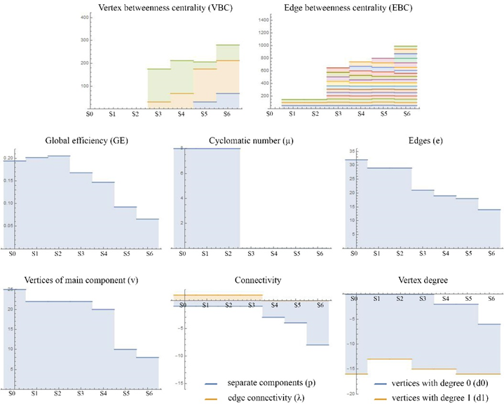
Changes of measures and indicators for different seismic scenarios of M-D graph at medium intensity (I2) with a comparison of the initial pre-disaster value (S0).

Slide 11
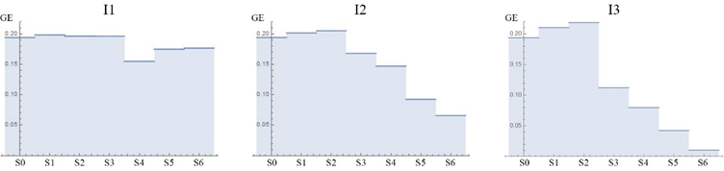
Changes in global efficiency for the M-D network at I1, I2 and I3 seismic intensity for different scenarios including pre-disaster performance (S0).

Slide 12
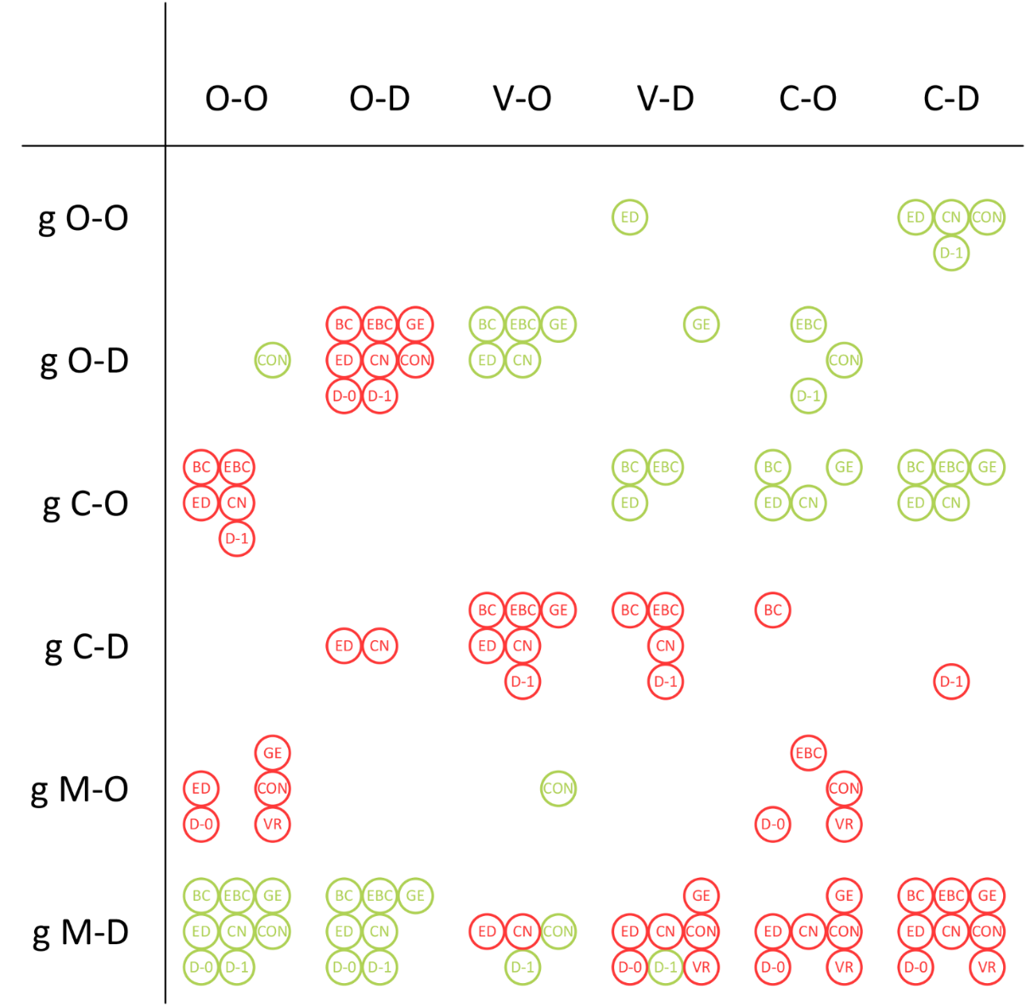
CONCLUSIONS
Comparisons between different systems and different scenarios.
Critical points in the system.
Correlation between centralities of affected element and loss of global efficiency.
Global efficiency should be supplemented by other measures and indicators.
A mesh configuration with diagonal street connections and outer circumference was recognized as most resilient.

