Slide 1
STREETS FOR 2030
PROPOSING STREETS FOR INTEGRATED AND UNIVERSAL MOBILITY
LJUBLJANA 23.&24.9.2020

Slide 2
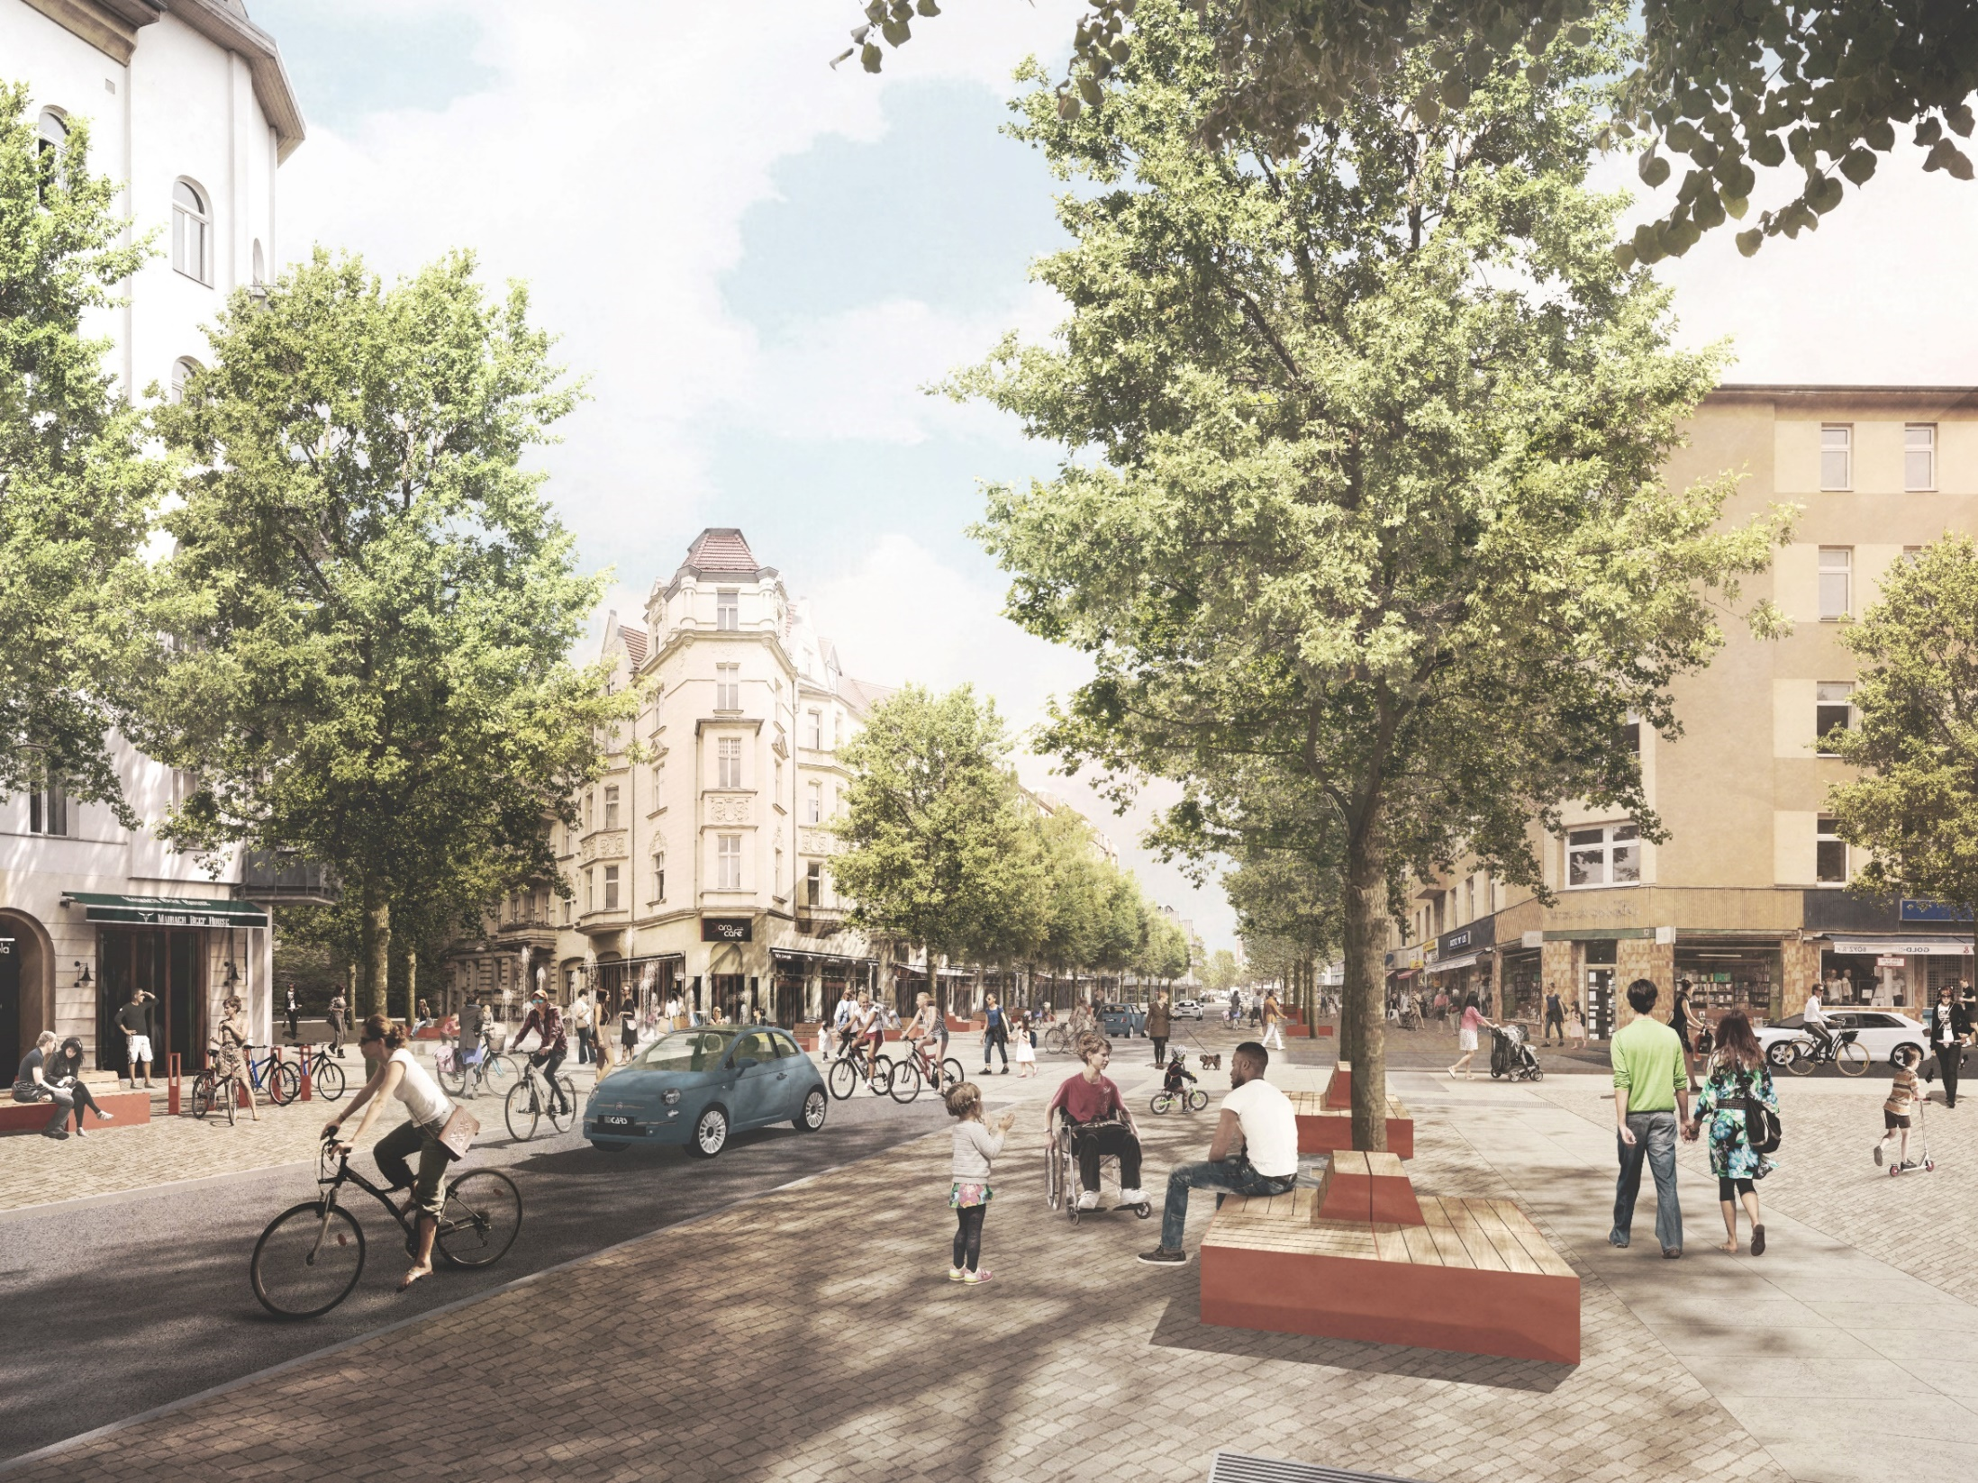
ANOTHER STREET IS POSSIBLE
Exploring Future Streetscapes Through Temporary Redistribution Strategies
Steffan Robel, A24 Landschaft

Slide 3
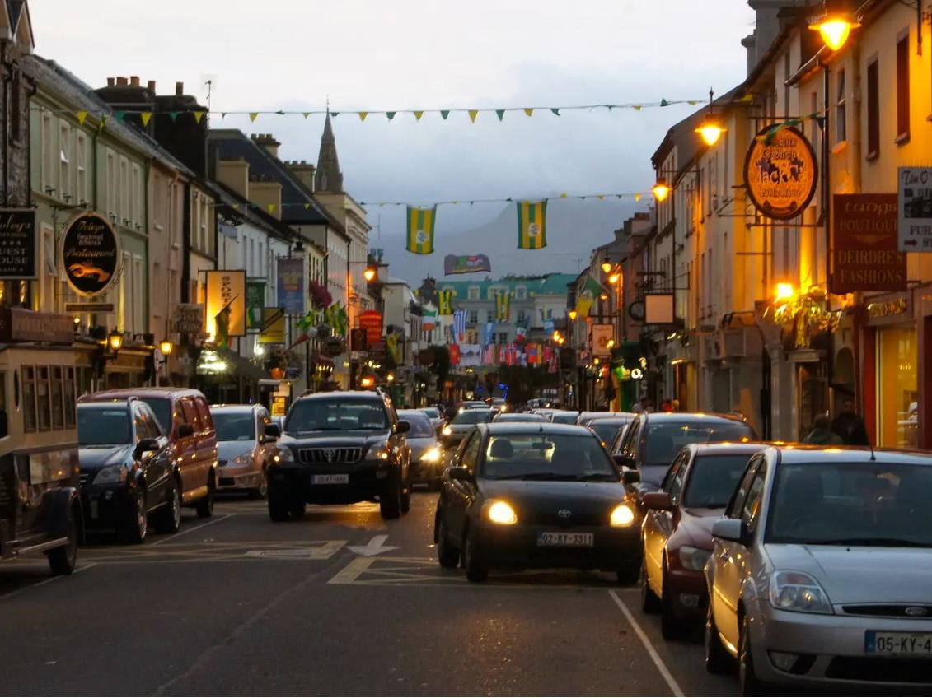
CITY WITHOUT CARS
https://pixabay.com/photos/killarney-ireland-city-traffic-959325/
City Street 4 I Another Street is Possible I Steffan Robel

Slide 4
CITY WITHOUT CARS?
https://pixabay.com/photos/killarney-ireland-city-traffic-959325/
City Street 4 I Another Street is Possible I Steffan Robel

Slide 5
CITY WITHOUT CARS!
https://pixabay.com/photos/killarney-ireland-city-traffic-959325/
City Street 4 I Another Street is Possible I Steffan Robel

Slide 6
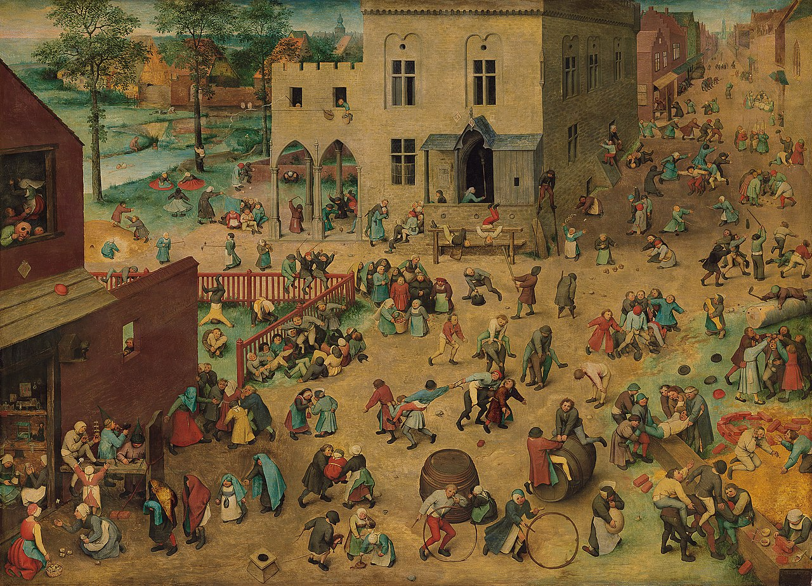
Streets before cars
Street space in the Middle Ages
https://www.senscritique.com/liste/Pieter_Brueghel_l_Ancien/353961
City Street 4 I Another Street is Possible I Steffan Robel
Pieter Bruegel: Les Jeux d‘enfants, 1560

Slide 7
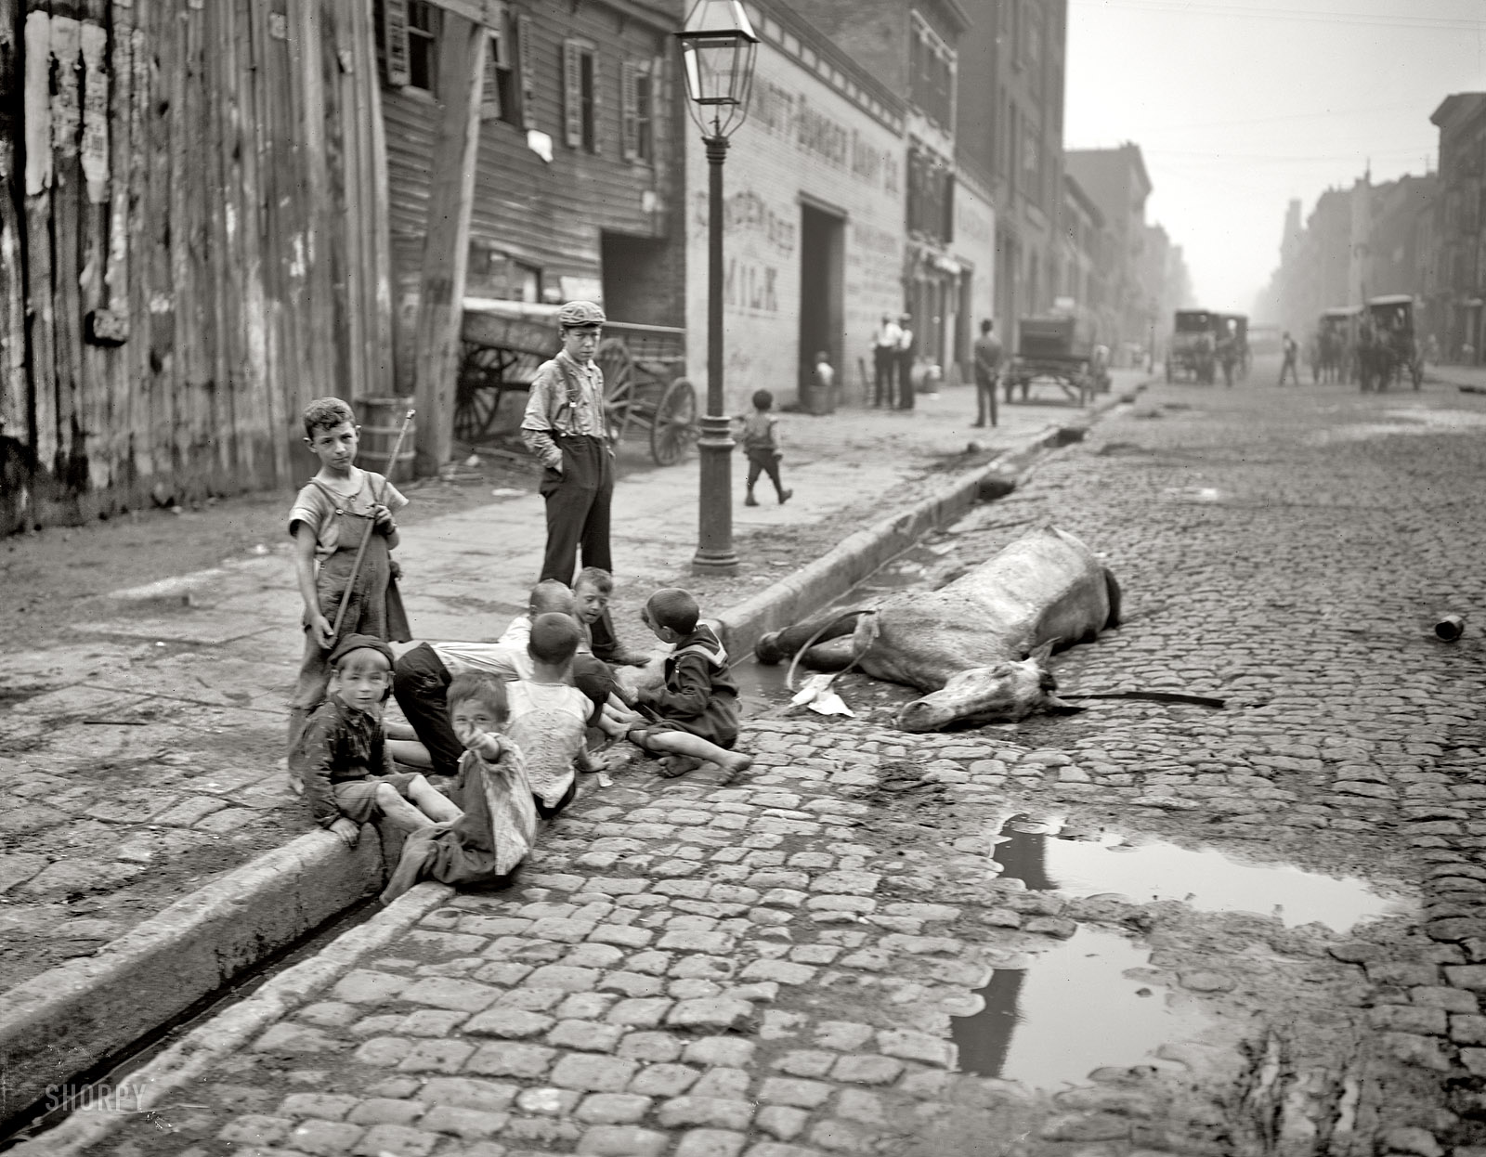
Streets before cars
Big cities in the early 20th Century
https://viewing.nyc/vintage-photograph-of-new-york-city-children-playing-next-to-a-dead-horse-in-1903/
City Street 4 I Another Street is Possible I Steffan Robel
New York City 1903

Slide 8
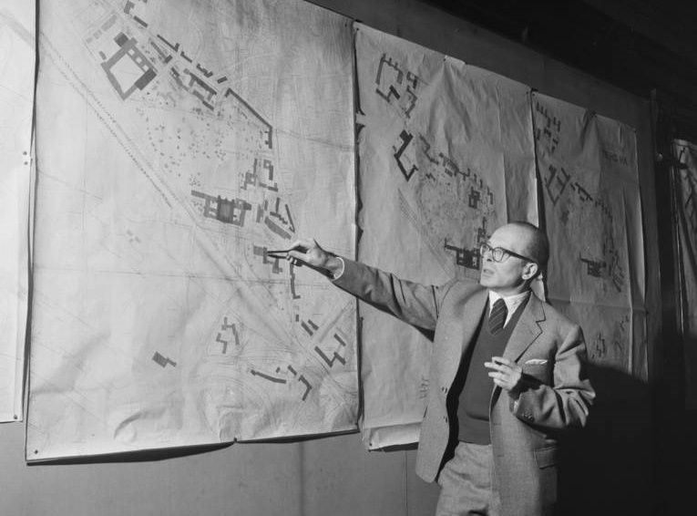
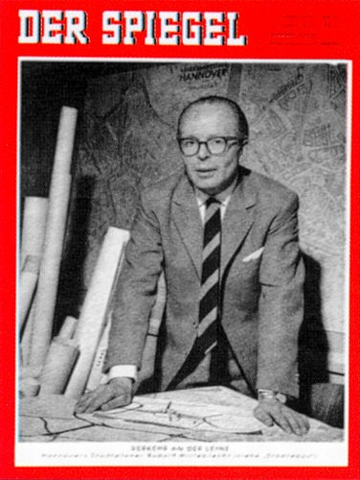
The car-friendly city
Rudolf Hillebrecht and the Wonder of Hannover
https://zeithistorische-forschungen.de/3-2017/id=5527
City Street 4 I Another Street is Possible I Steffan Robel

Slide 9
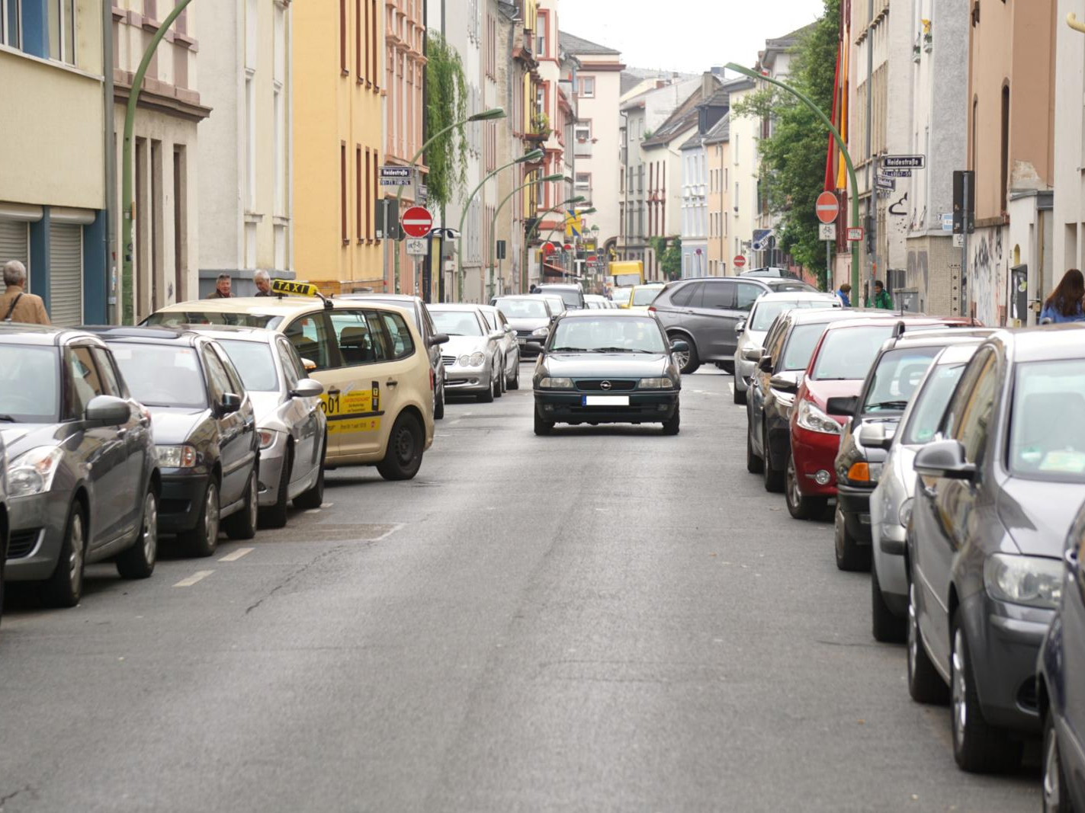
Traffic problems
Car dominance of the street
City Street 4 I Another Street is Possible I Steffan Robel

Slide 10
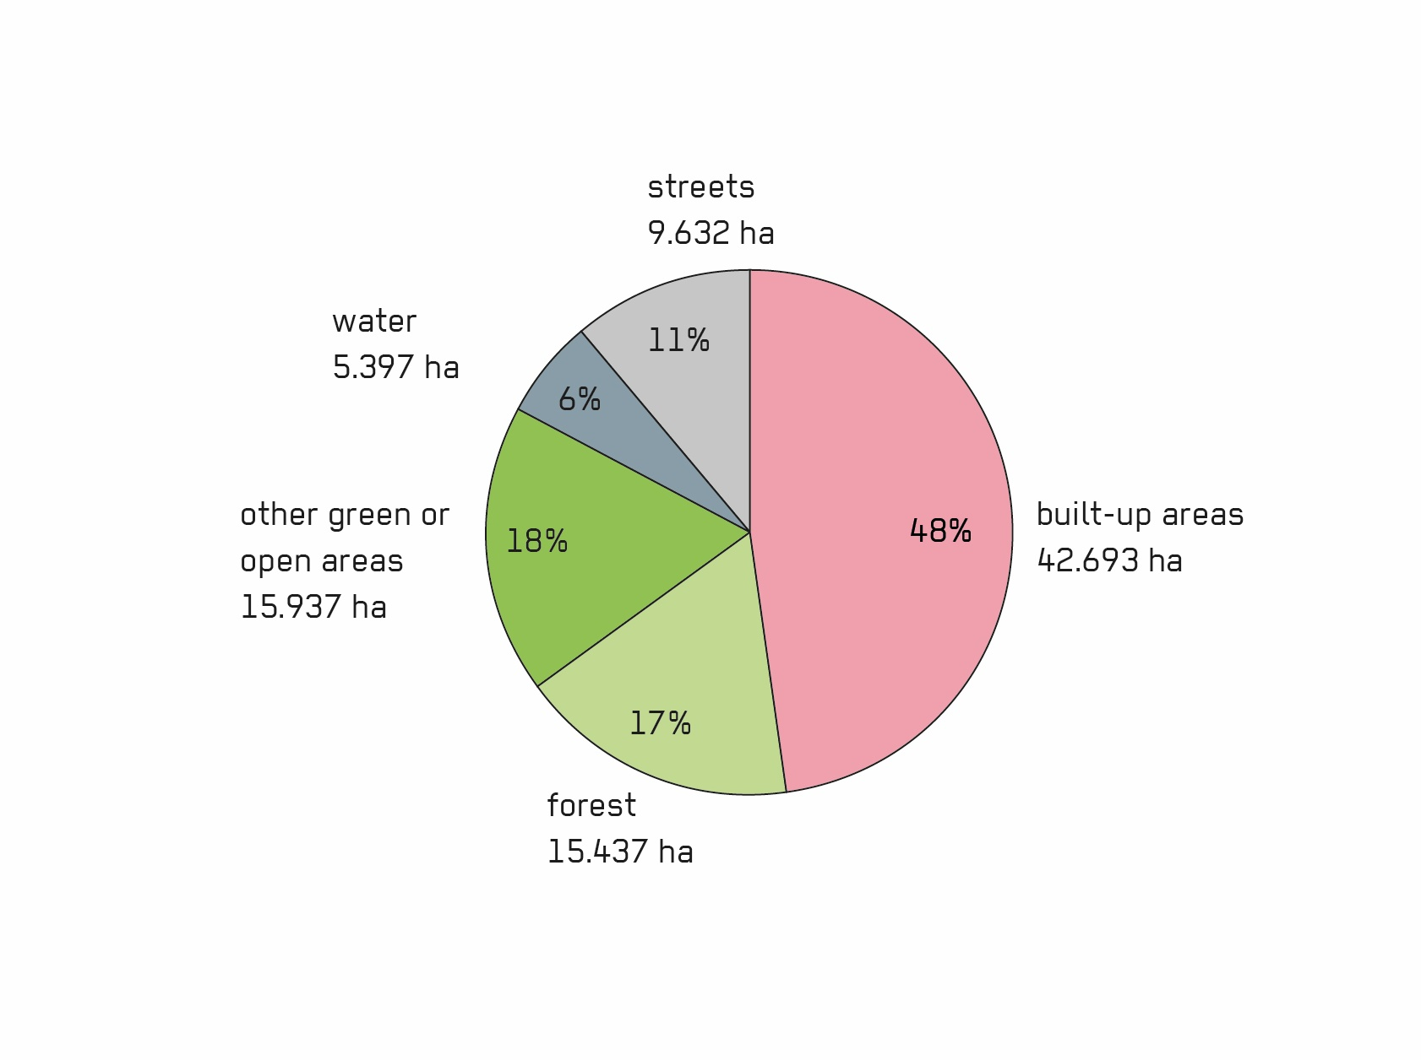
Land use Berlin
Environment Atlas Berlin 2016
https://stadtentwicklung.berlin.de/umwelt/umweltatlas/dinh_06.htm
City Street 4 I Another Street is Possible I Steffan Robel

Slide 11
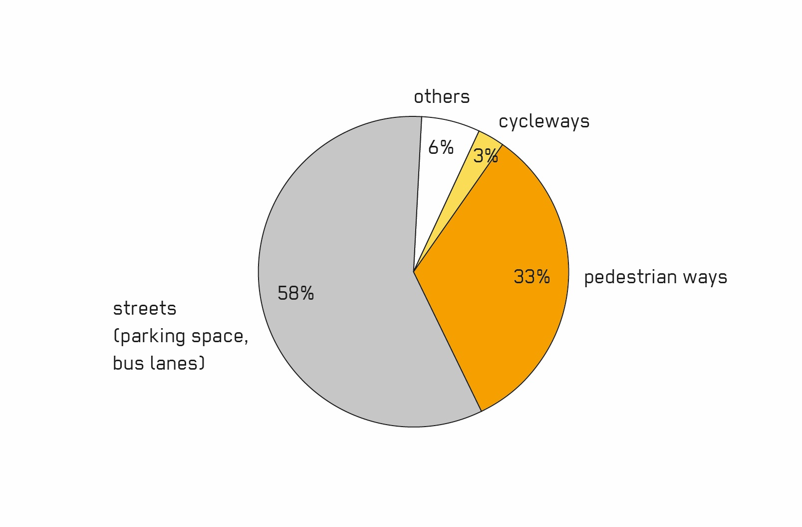
Distribution of space Berlin
Space Allocation Report 2014
https://www.clevere-staedte.de/blog/artikel/flaechen-gerechtigkeits-report-online
City Street 4 I Another Street is Possible I Steffan Robel

Slide 12
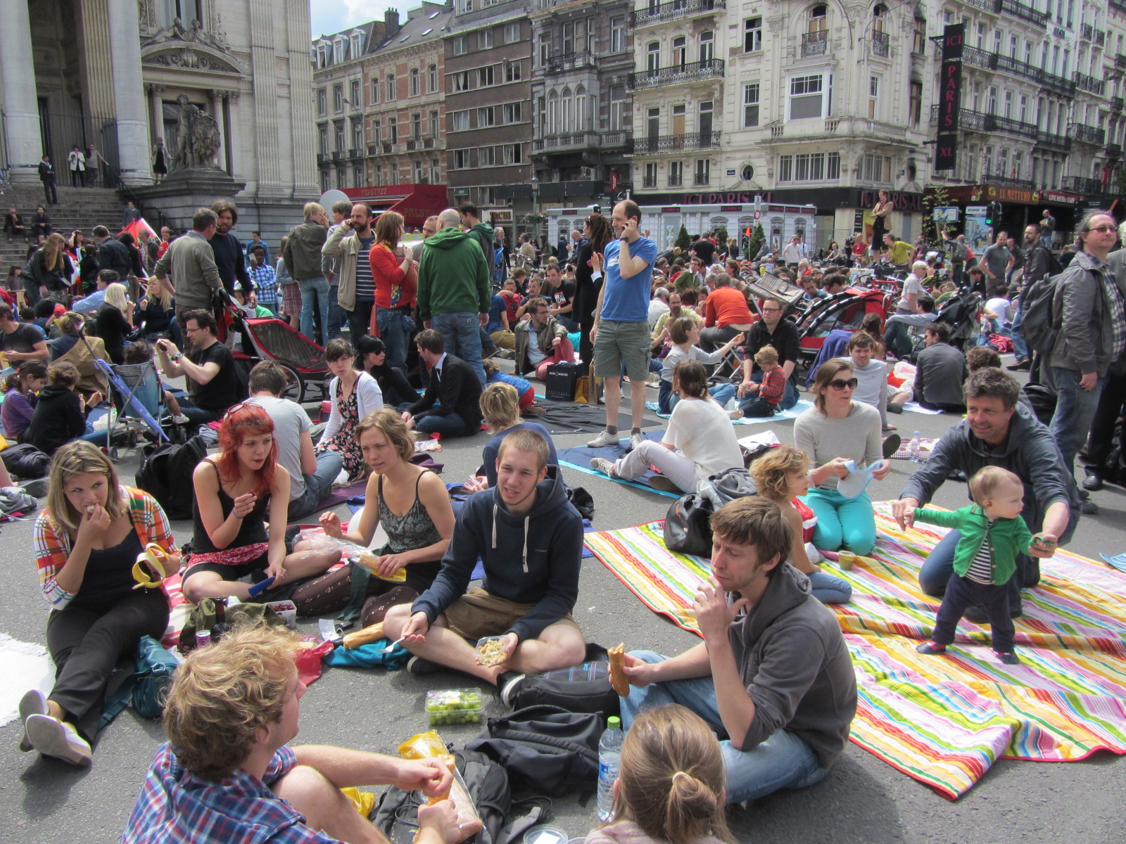
Values
Livable city
https://www.thepolisblog.org/2012/06/brussels-residents-picnic-to-reclaim.html
City Street 4 I Another Street is Possible I Steffan Robel

Slide 13
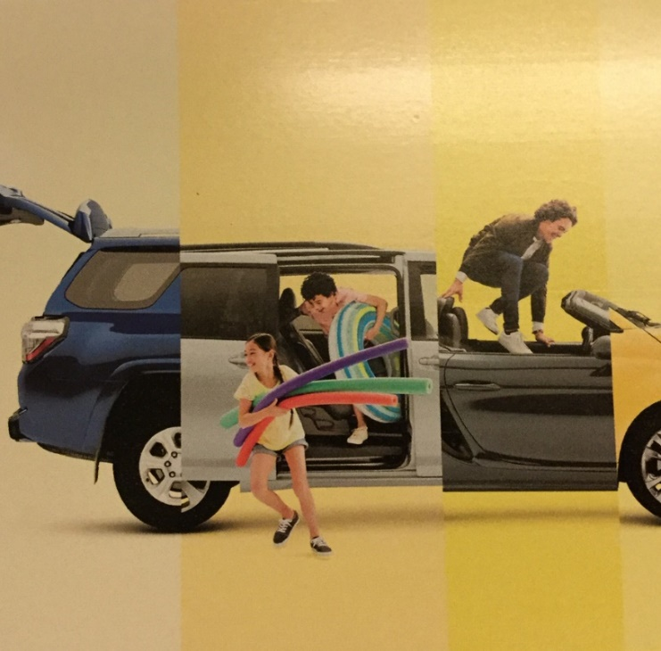
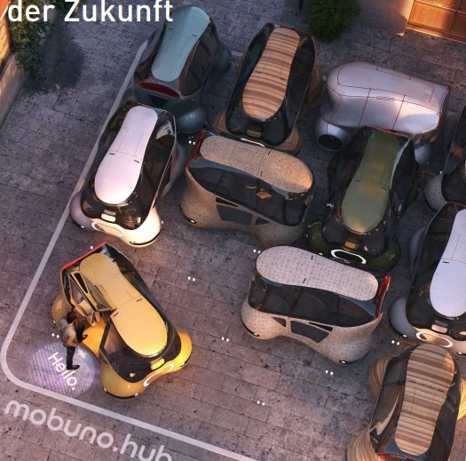
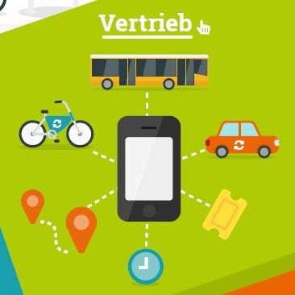
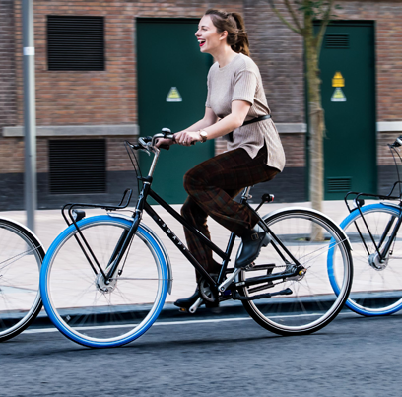
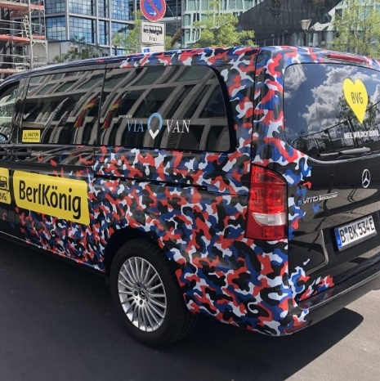
_-_Digitale_Infomappe_VCD.pdf
Future mobility
Connected, divided, electric, automated
https://www.vcd.org/fileadmin/user_upload/Redaktion/Themen/Multimodalitaet/Multimodal_unterwegs
City Street 4 I Another Street is Possible I Steffan Robel
VCD e.V. 2017

Slide 14
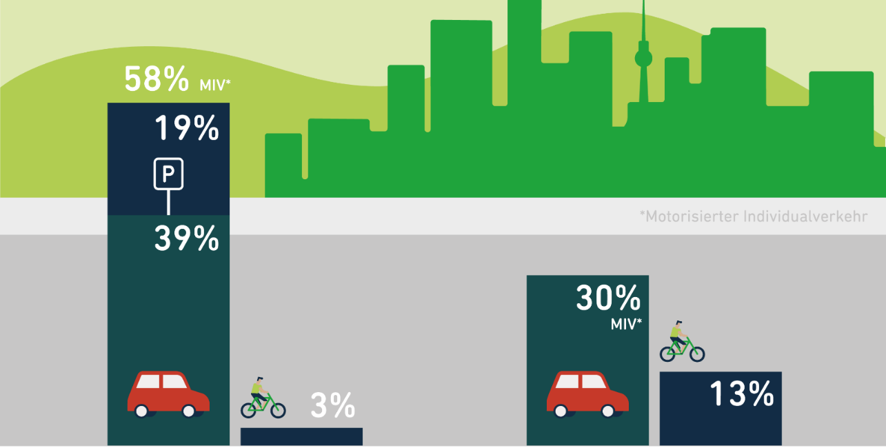
Space allocation
Modal Split and distribution of space Berlin
https://www.boell.de/de/2018/11/30/mobilitaet-gerecht-gestalten
Distribution of traffic space in Berlin Modal split in Berlin
City Street 4 I Another Street is Possible I Steffan Robel
Heinrich Böll Stiftung

Slide 15
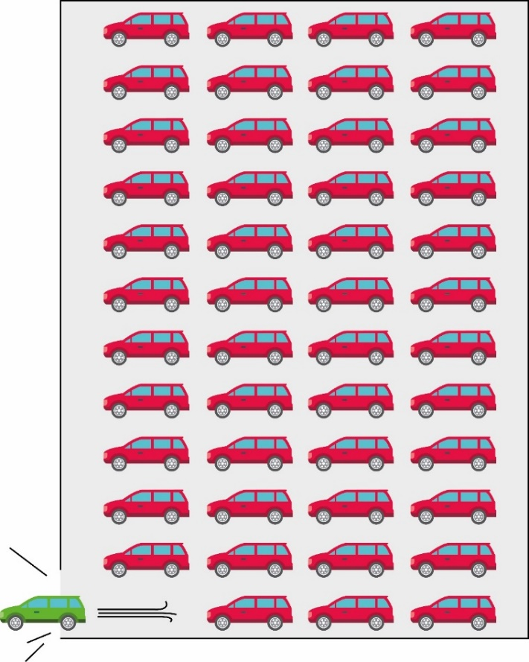
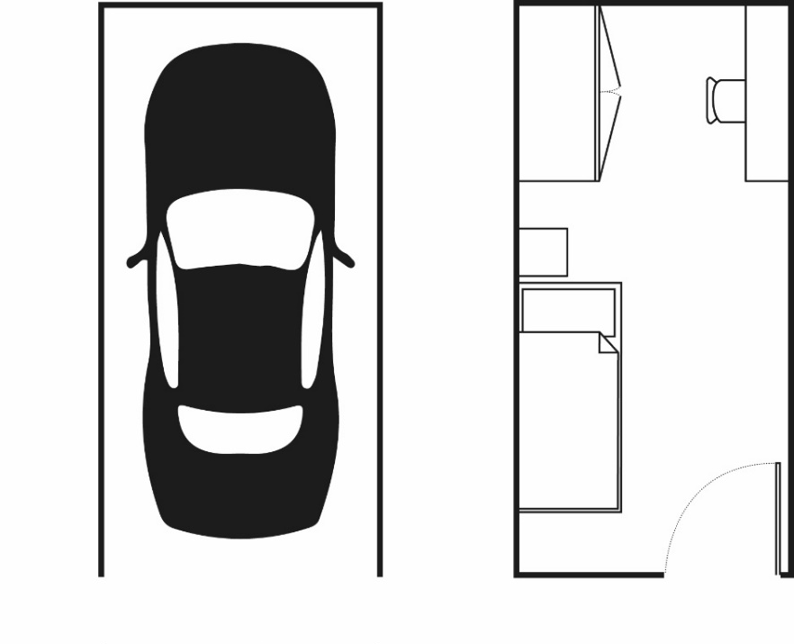
Vehicle usage
95% of the time cars are stationary – on the footprint of a children‘s room
City Street 4 I Another Street is Possible I Steffan Robel

Slide 16
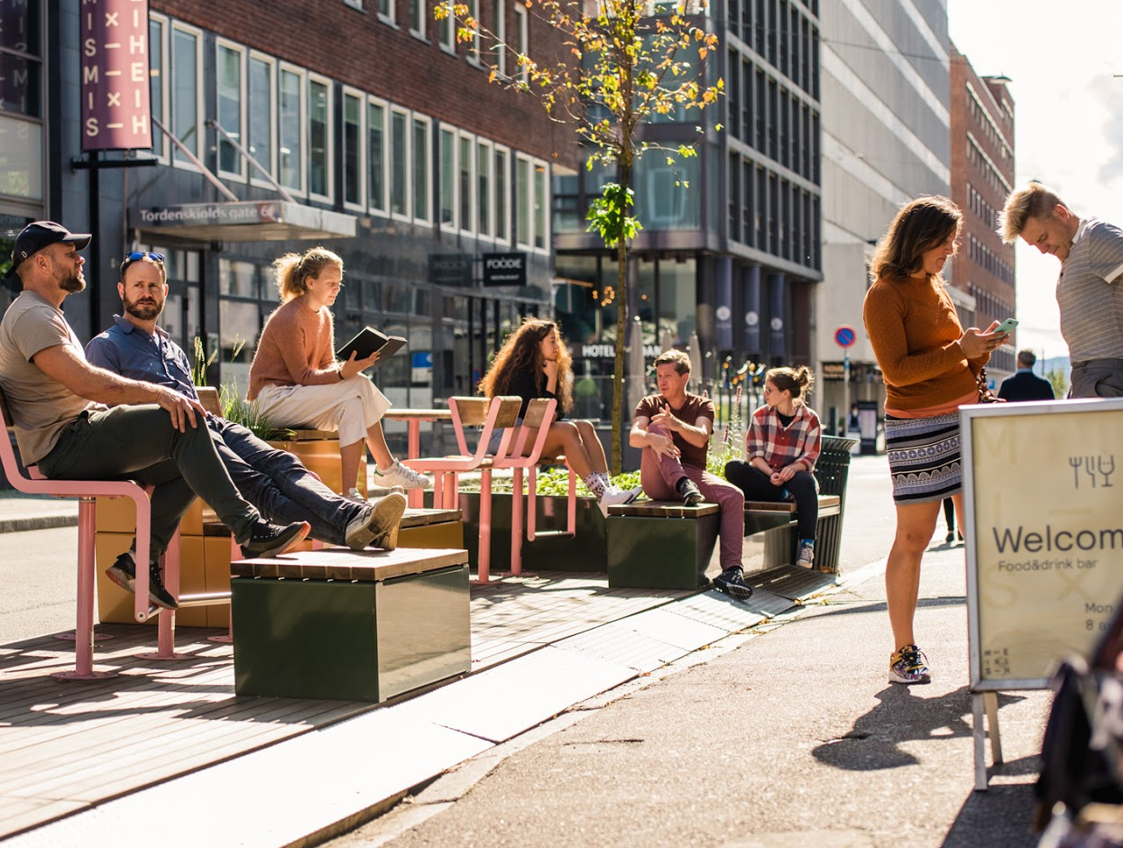
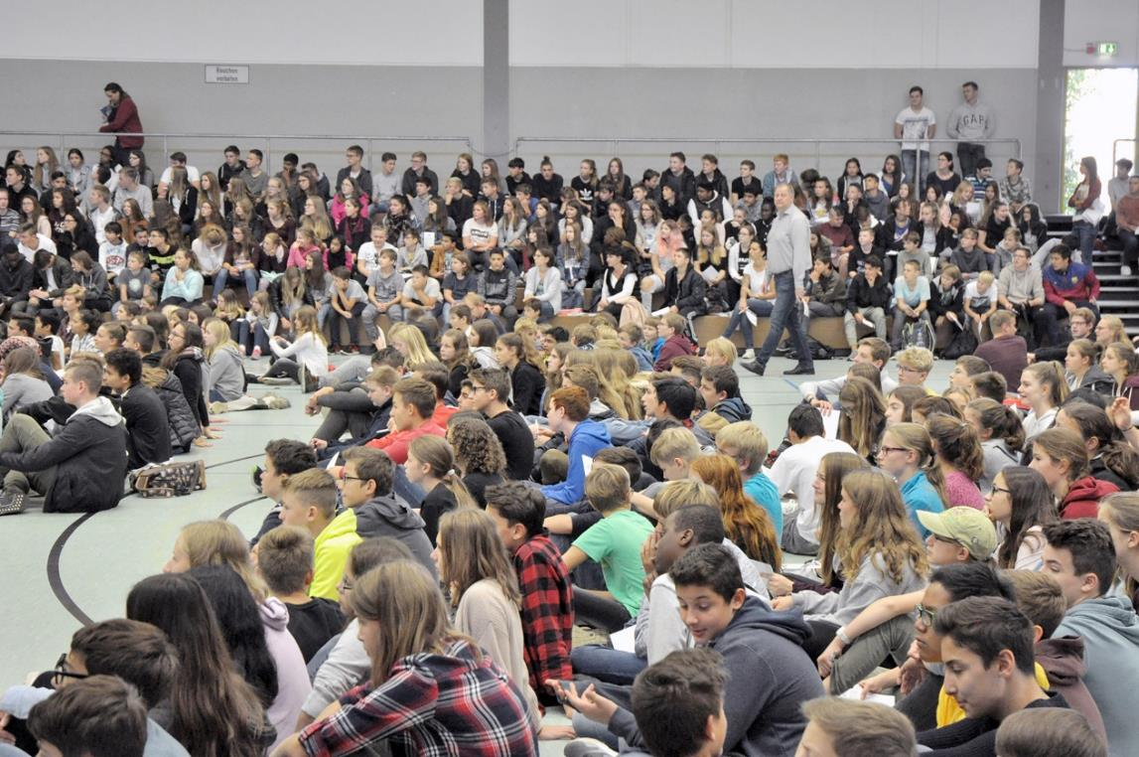
Negotiations
Tordenskjolds Gate Oslo
City Street 4 I Steffan Robel
Studio Oslo Landscape Architects (SOLA) and Vestre AS. Foto: Nicolas Tourrenc

Slide 17
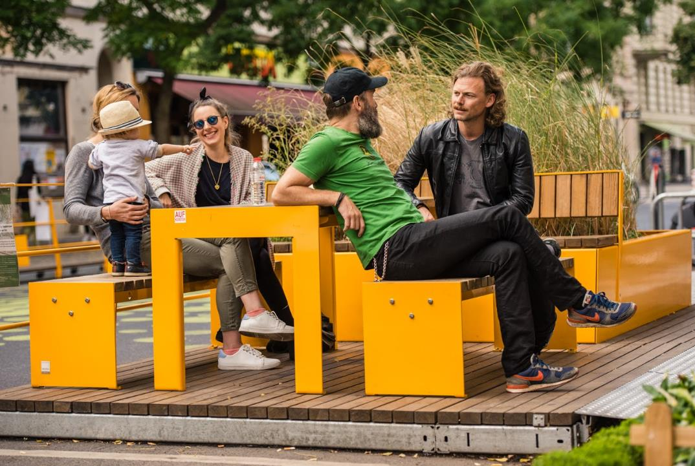
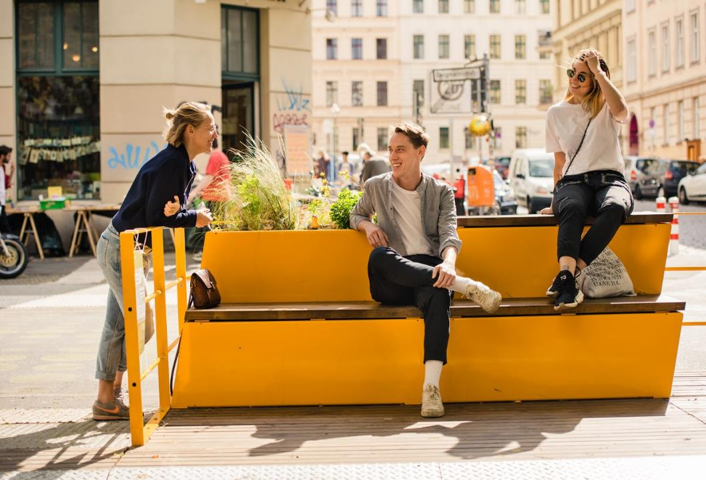
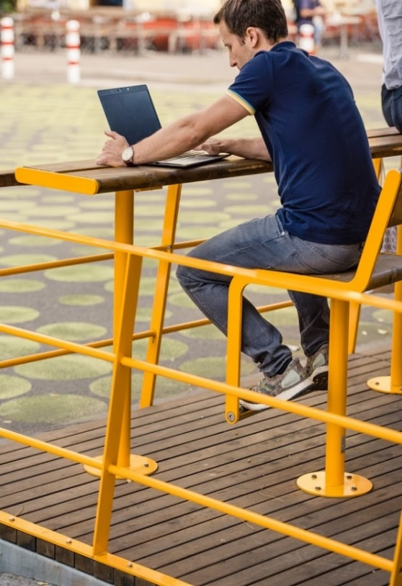
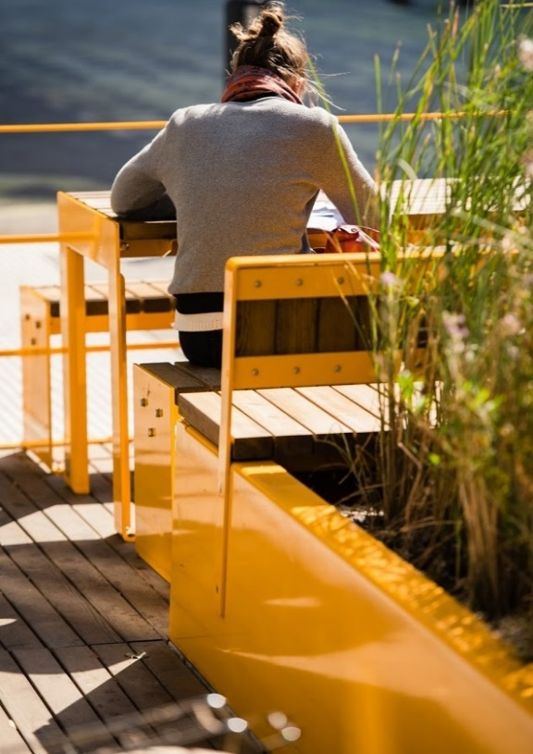
Negotiations
Bergmannstraße Berlin
City Street 4 I Another Street is Possible I Steffan Robel
A24 Landschaft and Vestre AS. Foto: Nicolas Tourrenc

Slide 18
Planning and design
Bergmannstraße Berlin
City Street 4 I Another Street is Possible I Steffan Robel

Slide 19
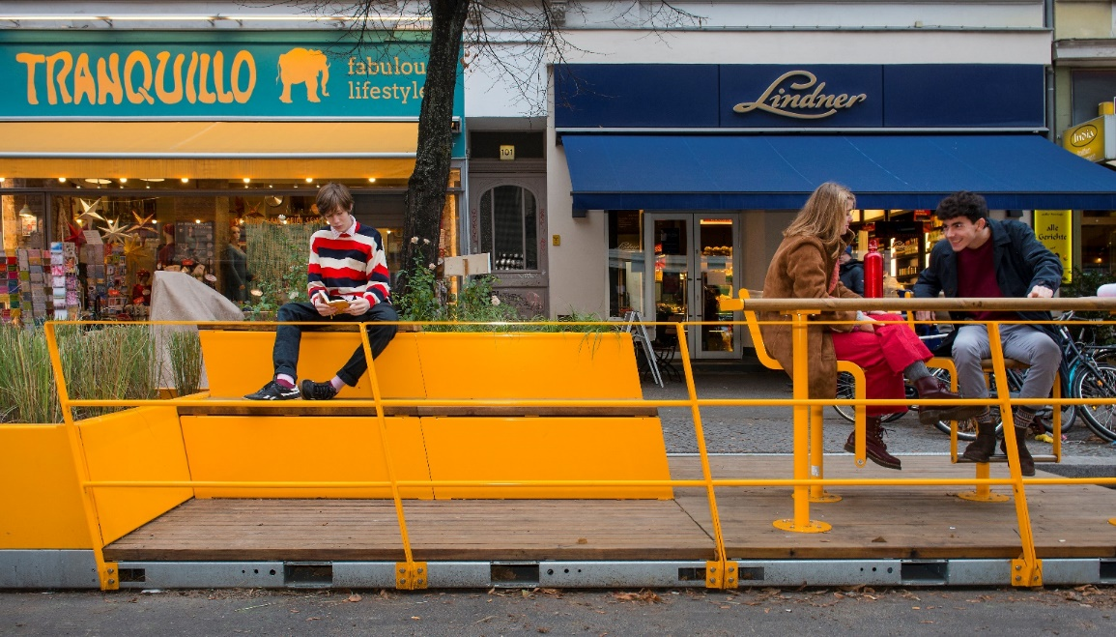
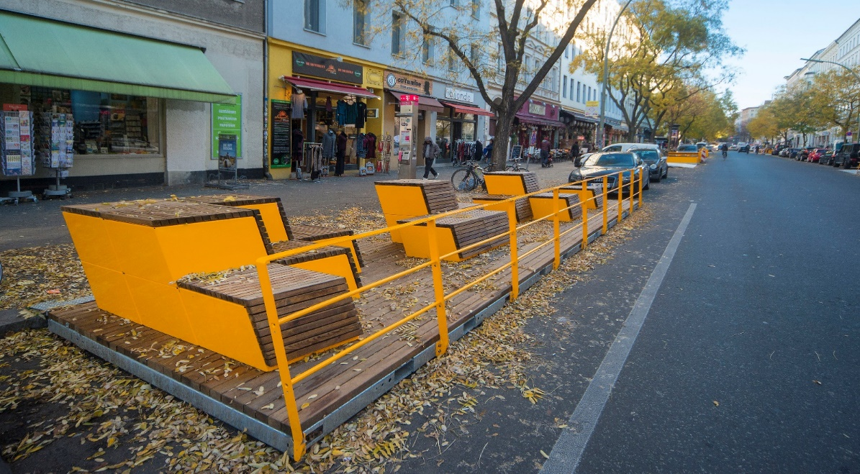
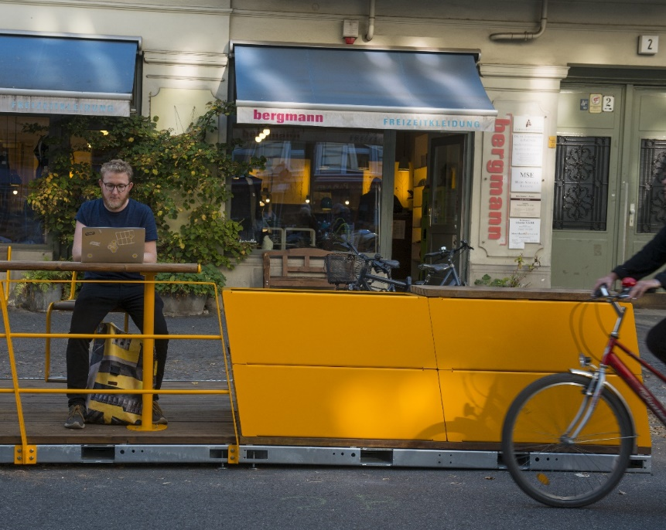
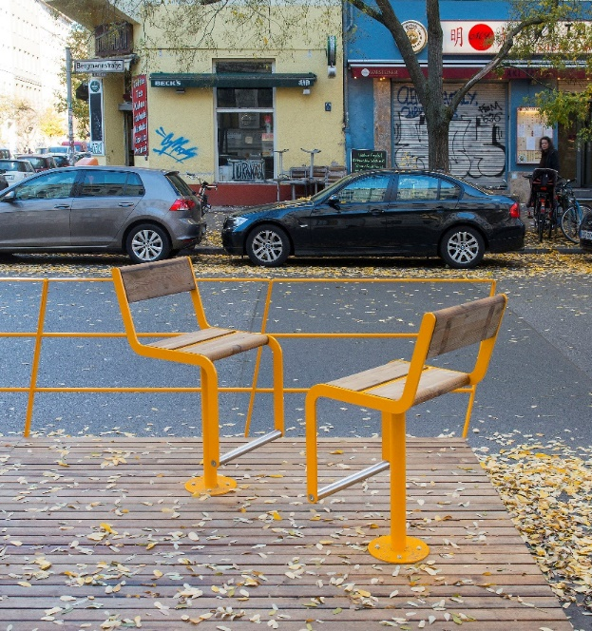
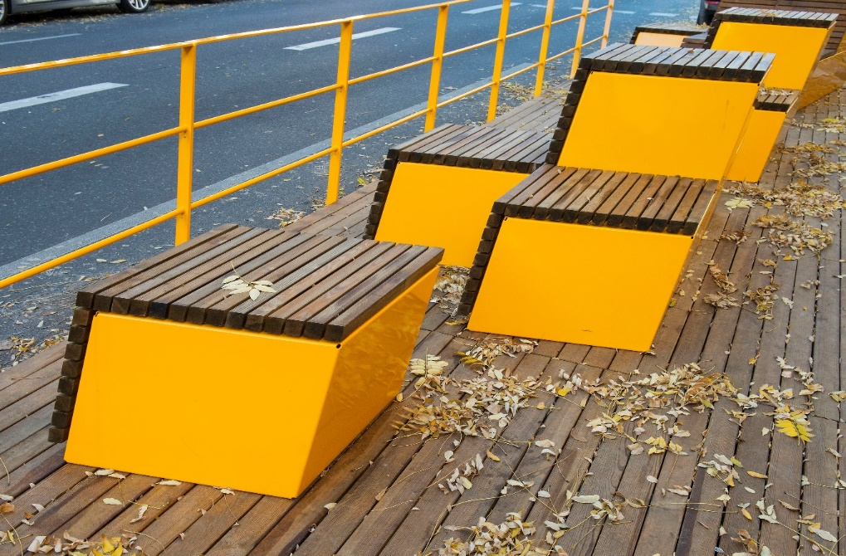
Modules
Bergmannstraße Berlin
City Street 4 I Another Street is Possible I Steffan Robel

Slide 20
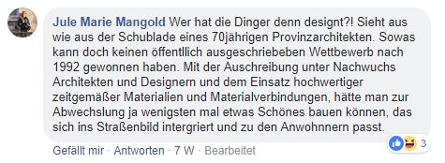
Feedback
Online participation platform
City Street 4 I Another Street is Possible I Steffan Robel
https://www.facebook.com/bergmannstrasse

Slide 21
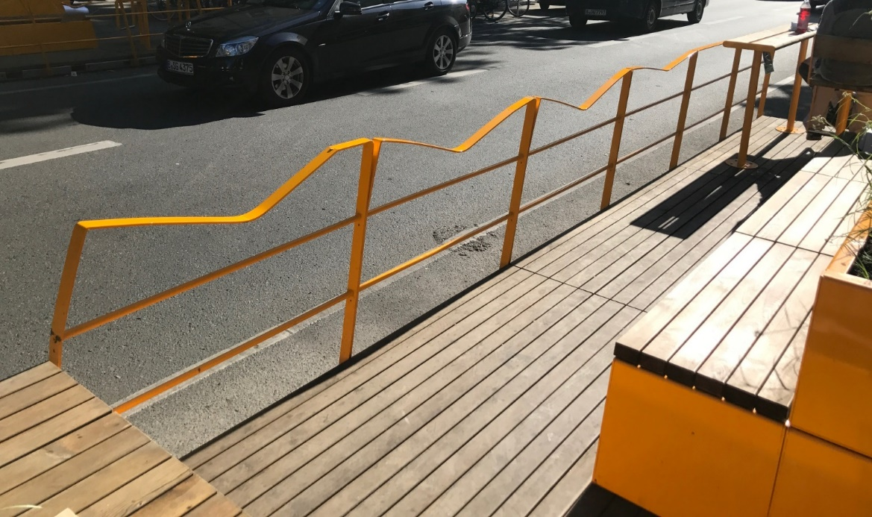
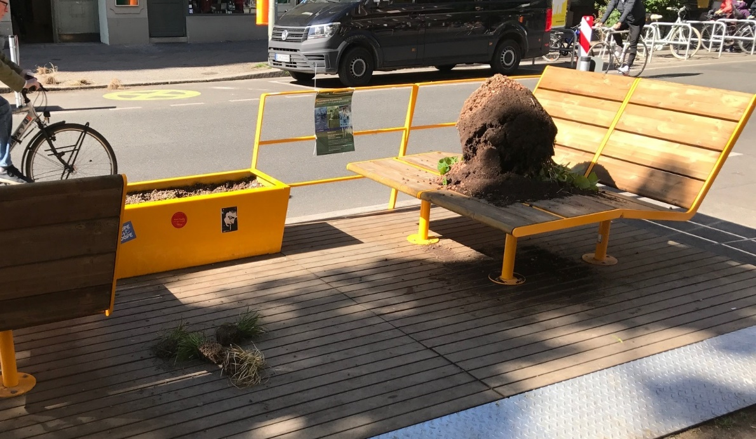
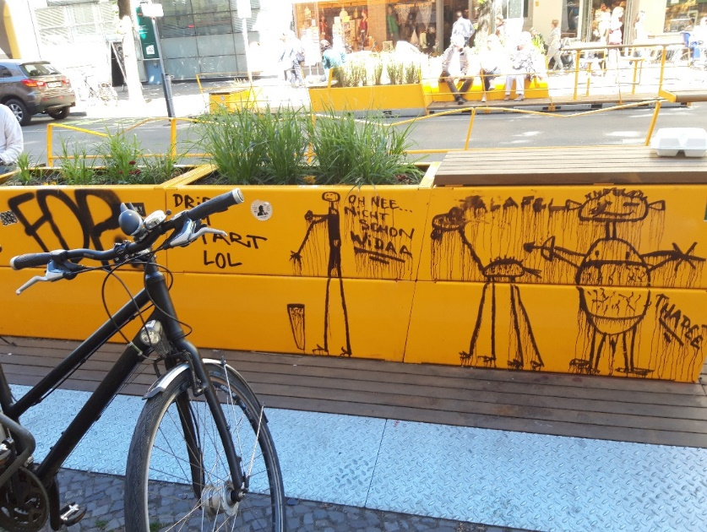
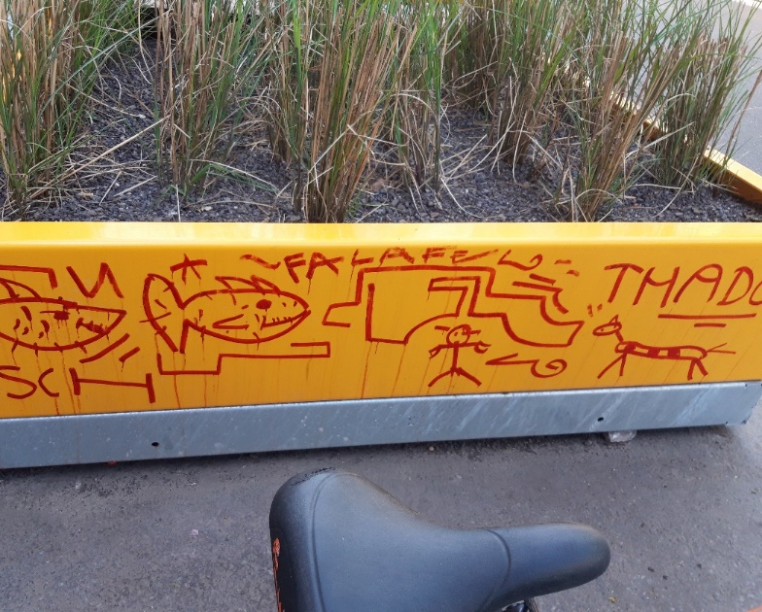
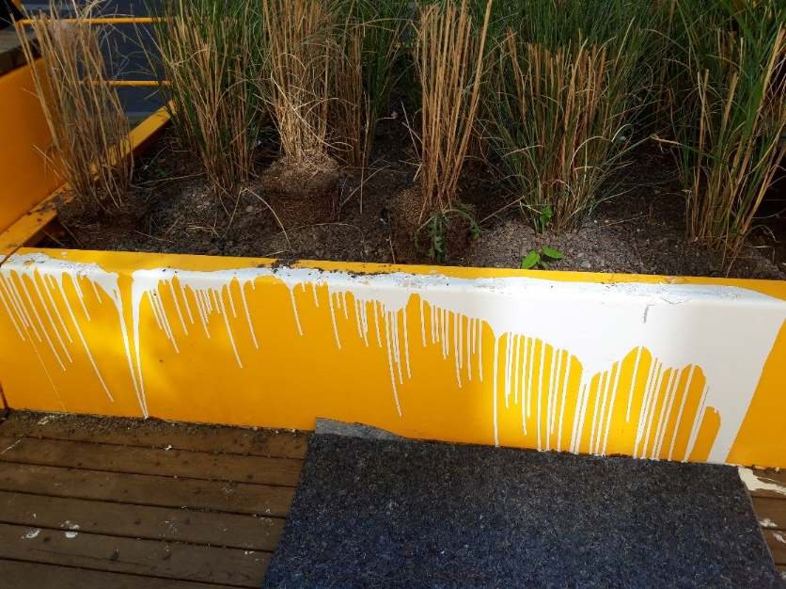
Feedback
Destruction and vandalism
City Street 4 I Another Street is Possible I Steffan Robel

Slide 22
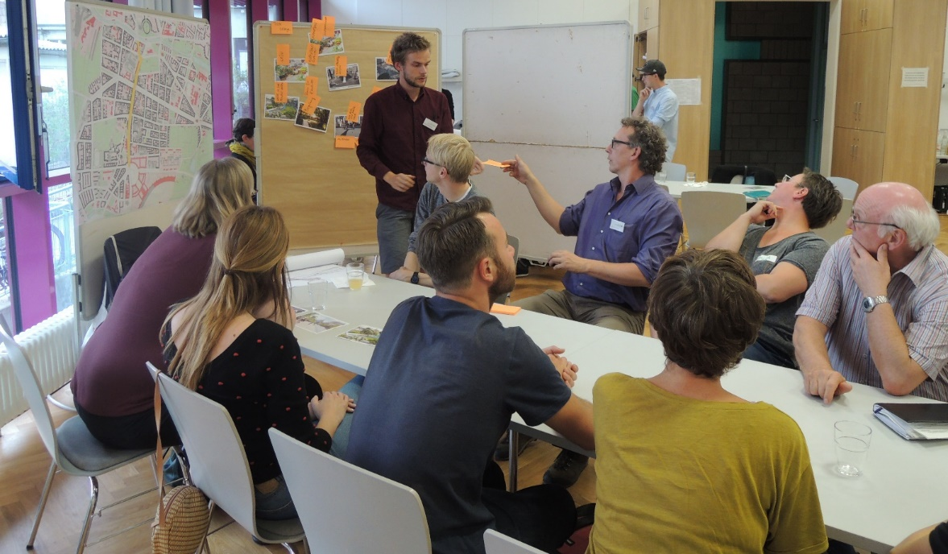
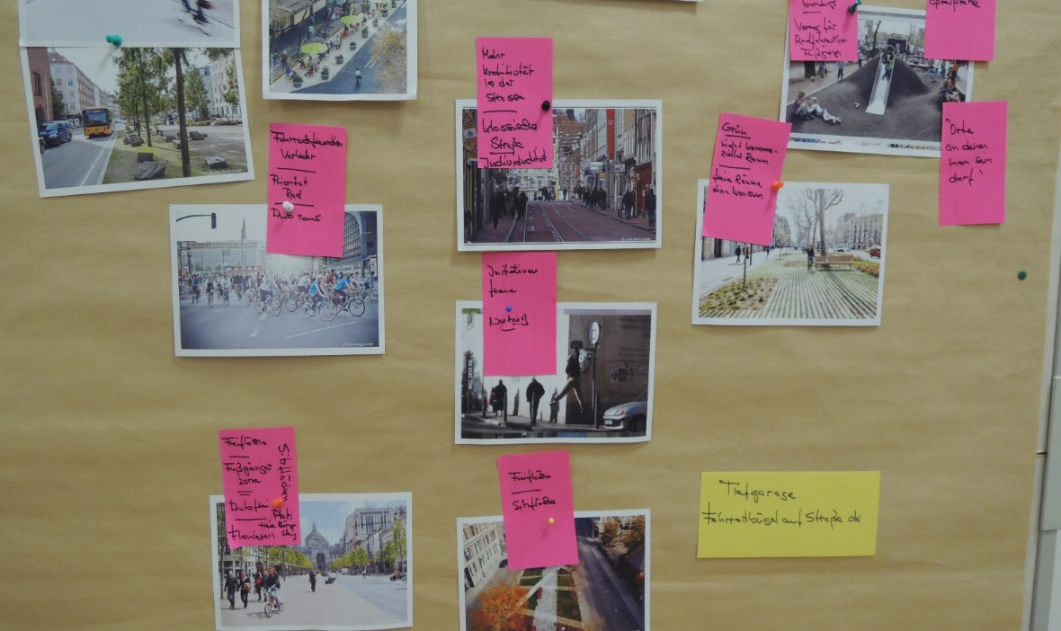
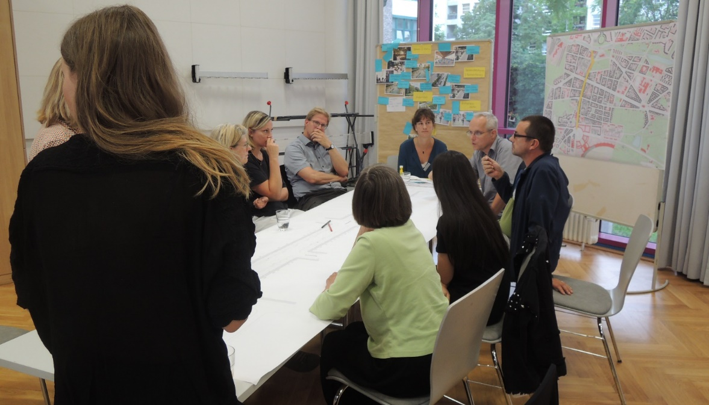
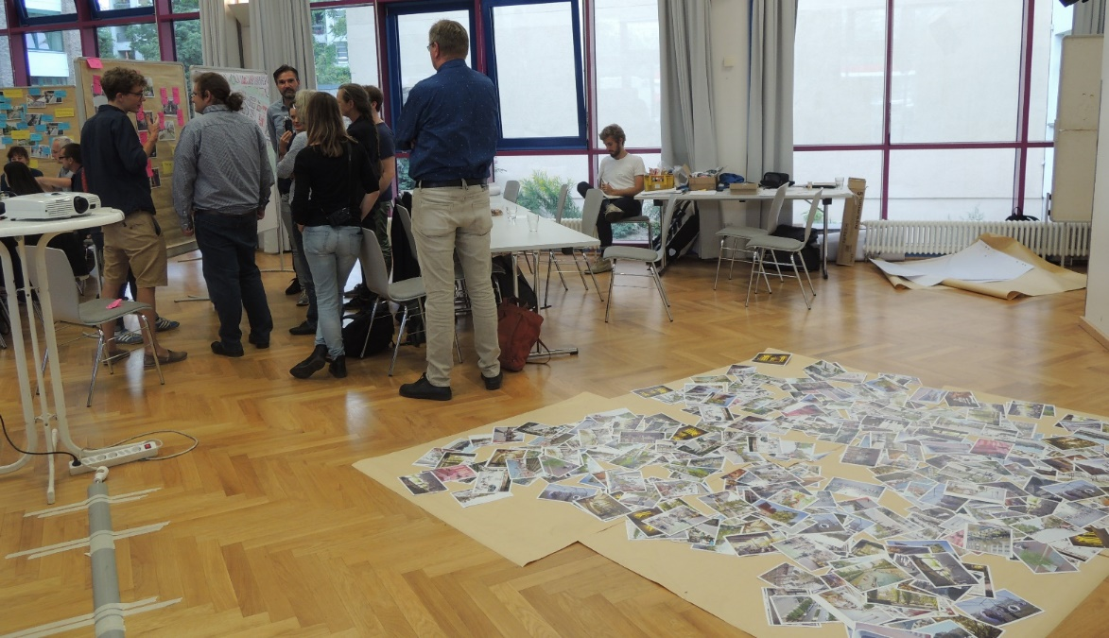
Participation
Workshops mit residents, Senate and District
City Street 4 I Another Street is Possible I Steffan Robel

Slide 23
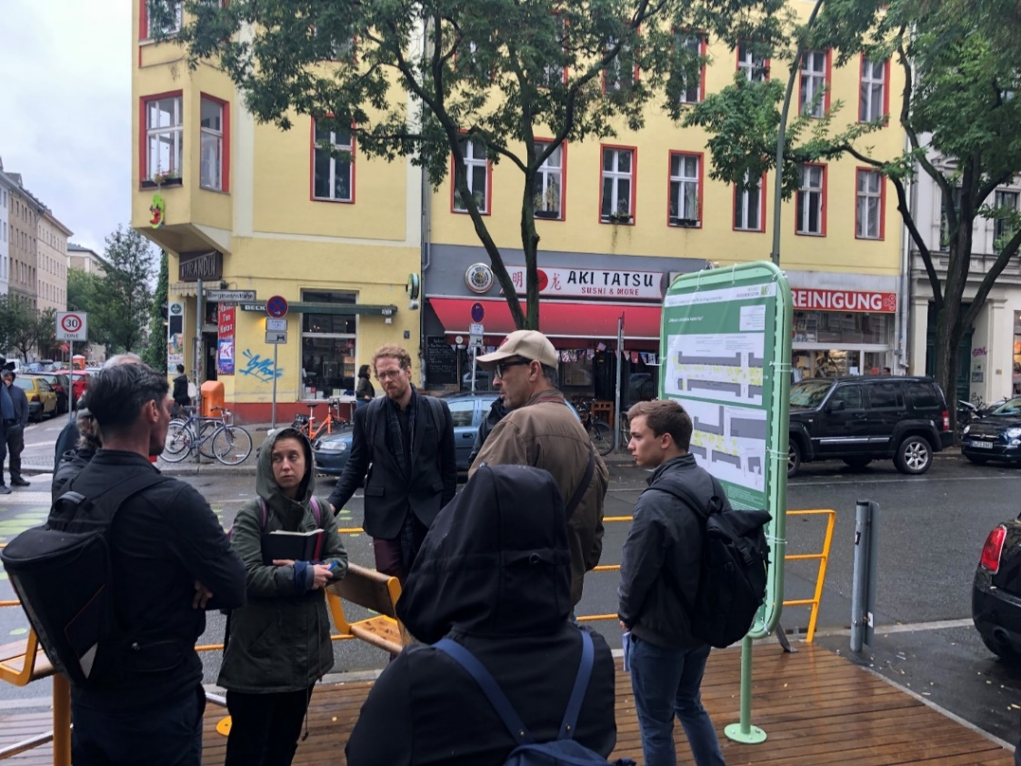
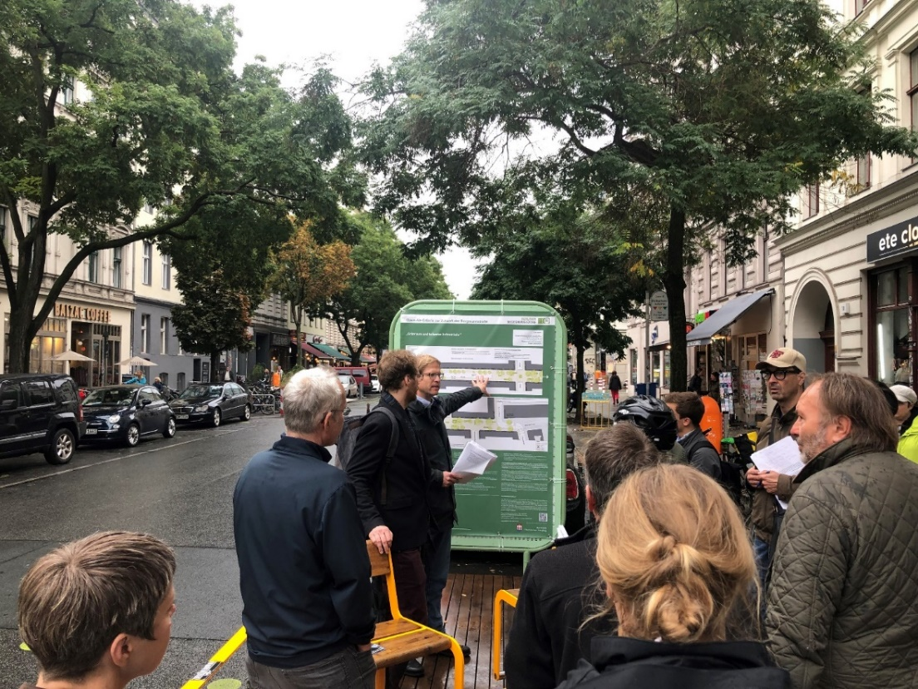
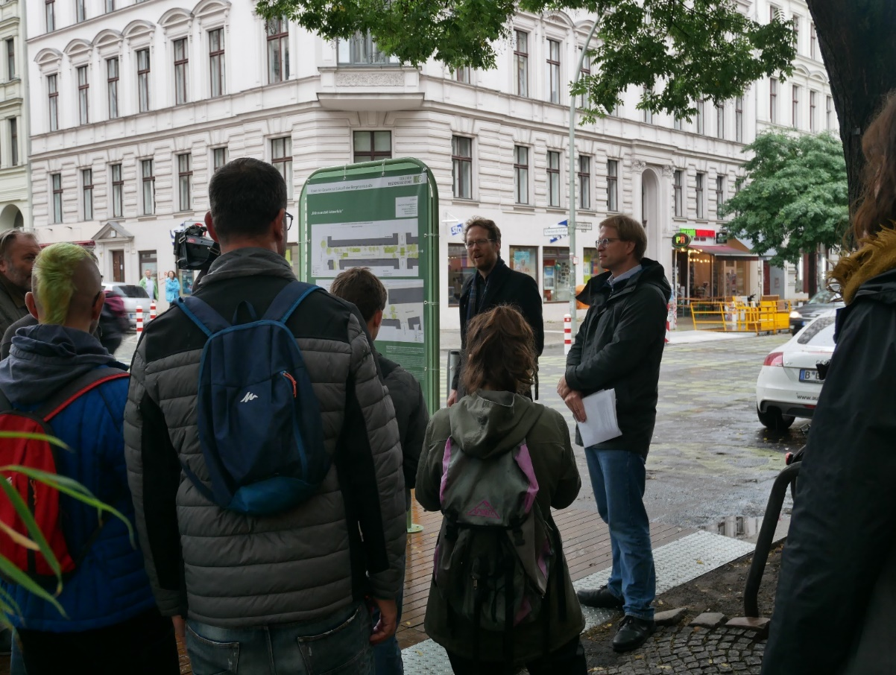
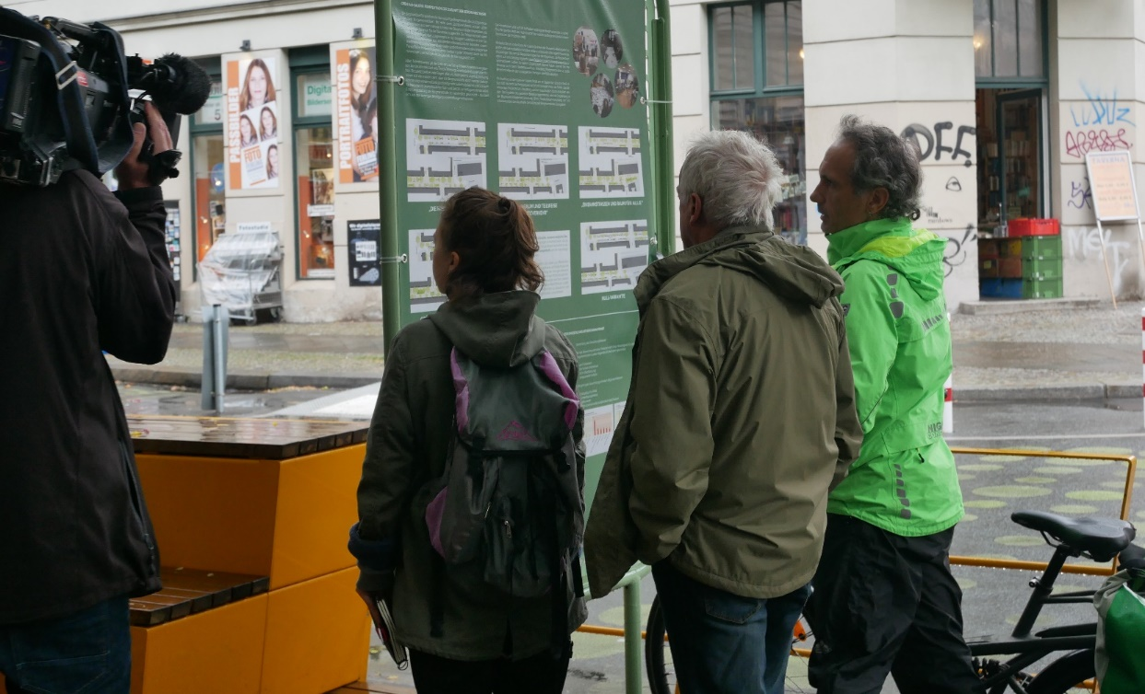
Participation
Bringing the discussion back to the site
City Street 4 I Another Street is Possible I Steffan Robel

Slide 24
MODULES
Participation
Result of the workshops
City Street 4 I Another Street is Possible I Steffan Robel

Slide 25
ANOTHER STREET IS POSSIBLE
Exploring Future Streetscapes through Temporary Redistribution Strategies

