Slide 1
STREETS FOR 2030
PROPOSING STREETS FOR INTEGRATED AND UNIVERSAL MOBILITY
LJUBLJANA 23.&24.9.2020
Towards a Walkable City: A Case Study of Zouk Mosbeh
Authors: Dima Jawad, PhD, Maya El Chakhtoura, Julien Semaan, Nasri Khneisser, Paul Boulos

Slide 2
Outline
Introduction
Problem Definition and Objectives
Research Methodology
Literature Review and Design Standards
Case Study: Zouk Mosbeh Town
Streets Site Investigation
Streets Site Assessments
Recommendations for Design Interventions
Conclusion
References

Slide 3
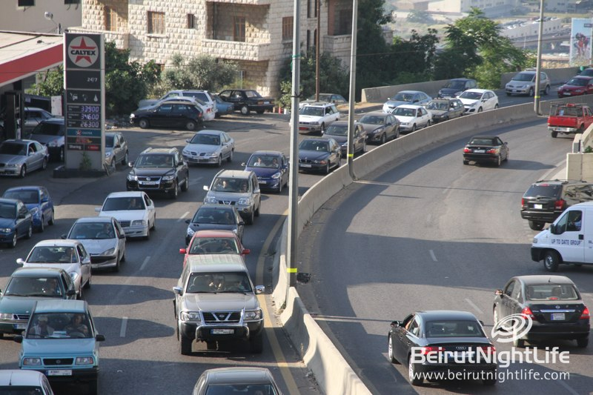
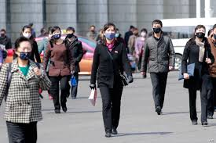
Introduction: Background
Figure 1: Traffic congestion in Zouk Mosbeh
Figure 2: Pedestrian-friendly city
Figure 3: Pedestrians during pandemic

Slide 4
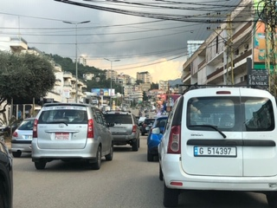
Problem Definition:
Figure 4: Traffic congestion in Zouk Mosbeh
Traffic congestion and air pollution are serious problems in Zouk Mosbeh .

Slide 5
Objectives:
Investigating how to convert the car-dependent Zouk Mosbeh into a pedestrian-friendly city.
Identifying a set of recommendations and strategies.

Slide 6
Research Methodology: Establishing state-of-the-art
Literature review
Tailoring the components for pedestrian-friendly city
Multi-criteria analysis Model
Street site assessments
Photography and street site measurements
Field traffic observations
Plotted cross-sections and maps
Codes and standards

Slide 7
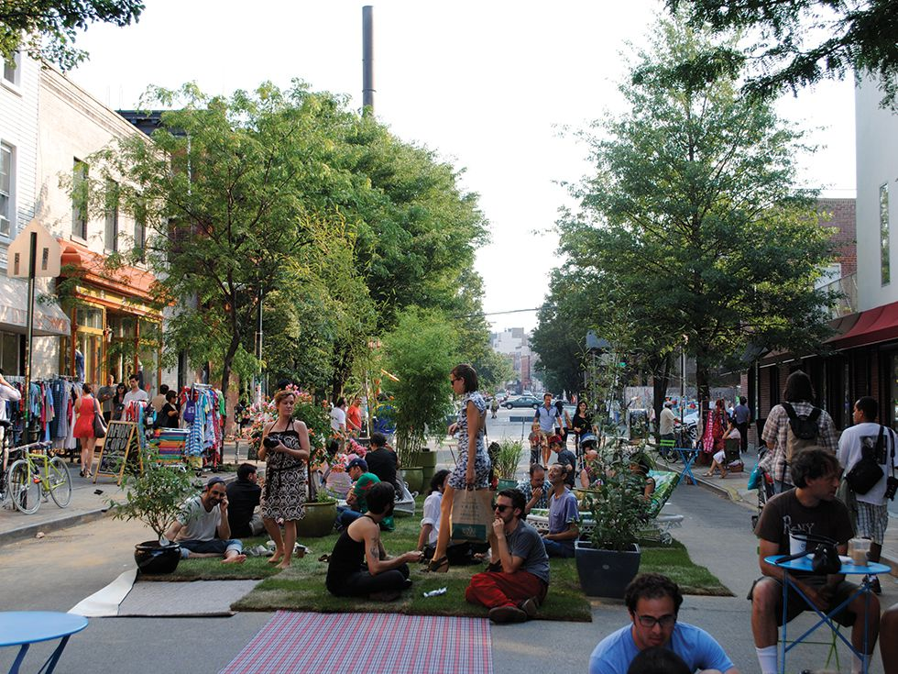
Literature Review:
Moudon, et al. (2006)
Presented theoretical and empirical insights on how to define walkable neighborhood from an operational point of view.
Figure 5: walkable urban setting

Slide 8
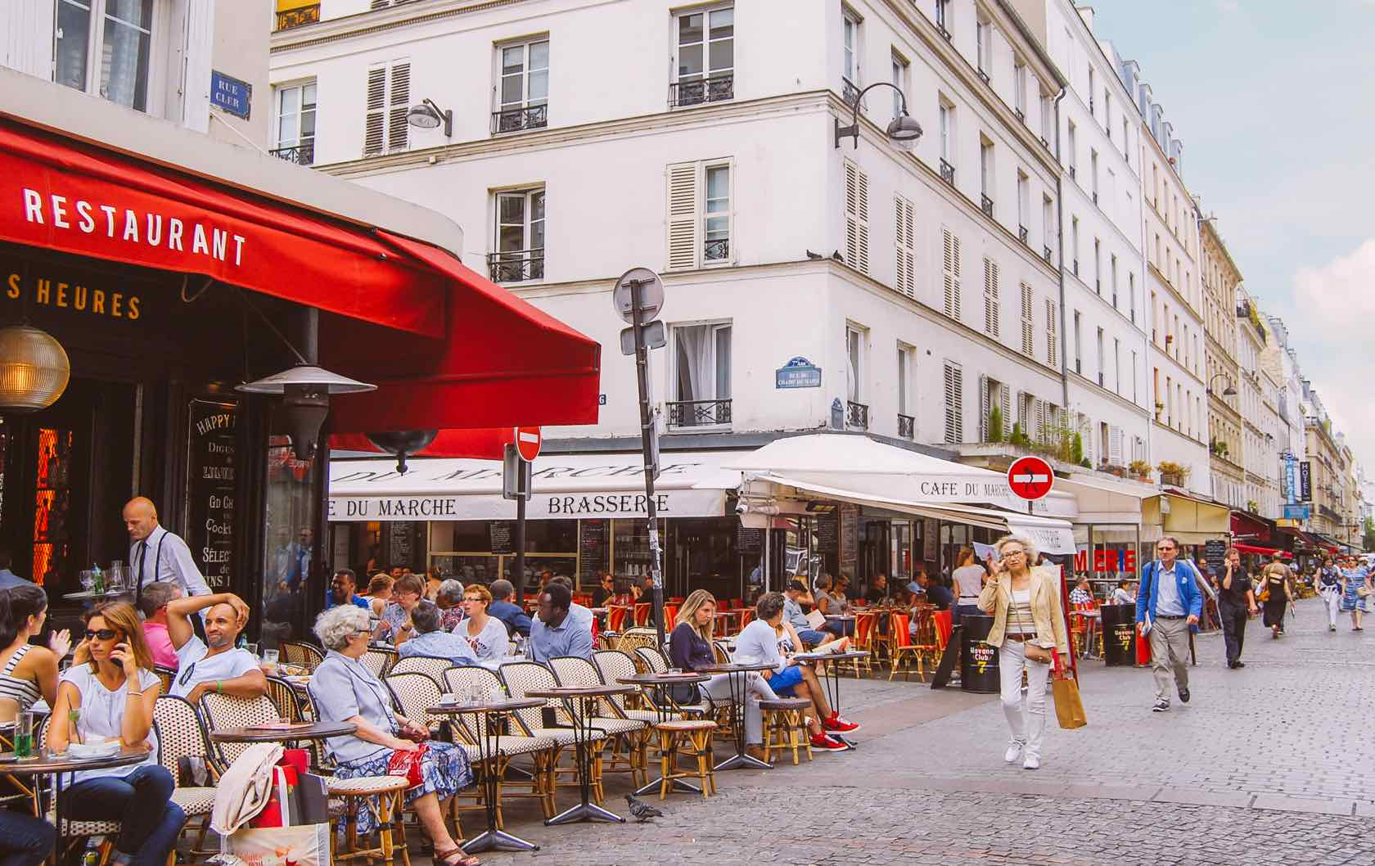
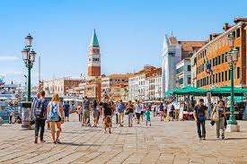
Literature Review:
Bödeker (2018)
Investigated the perception of walking and walkability in pre-set and self-defined neighborhoods in older adults using mental mapping interviews.
Figure 6: Restaurant streets
Figure 7: Venice pedestrian activity

Slide 9
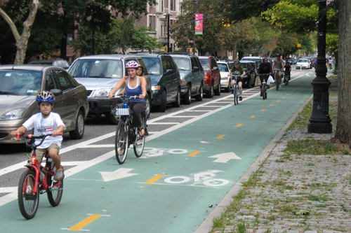
Literature Review:
Jabbari & Rodriguez Ramos (2020)
Performed a multi-criteria model analysis to evaluate the pedestrian conditions.
Figure 8: New York city bike lane

Slide 10
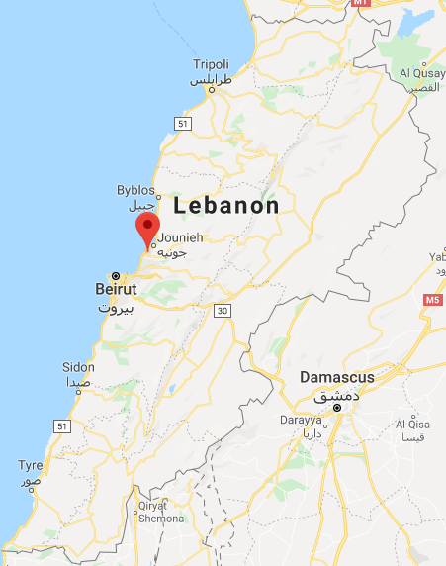
Case Study: Zouk Mosbeh Town Location and area
Location: Zouk Mosbeh
Governorate: Mount Lebanon
District: Keserwan
Population: 80,000
Weather: hot dry summers, cool moist winters
Table 1- Lebanon map with Zouk Mosbeh pinned location
Distance from Beirut (km) | Altitude (m) | Surface Area ($m^{2}$)
12 | 0 - 170 | 4,480,000
Figure 12: Lebanon map with Zouk Mosbeh pinned location

Slide 11
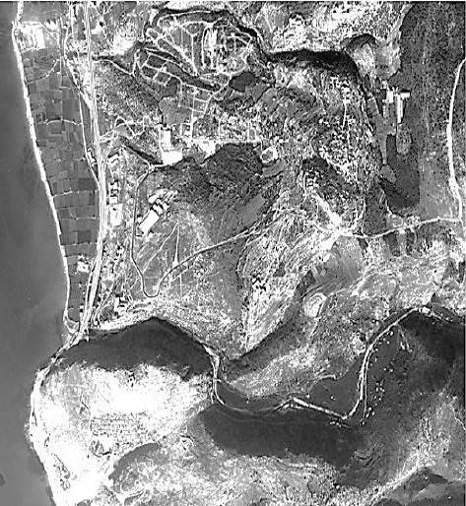
Case Study: Zouk Mosbeh Town Urban Growth
Figure 13: Aerial view of Zouk Mosbeh 1962
Figure 14: Aerial view of Zouk Mosbeh 2019

Slide 12
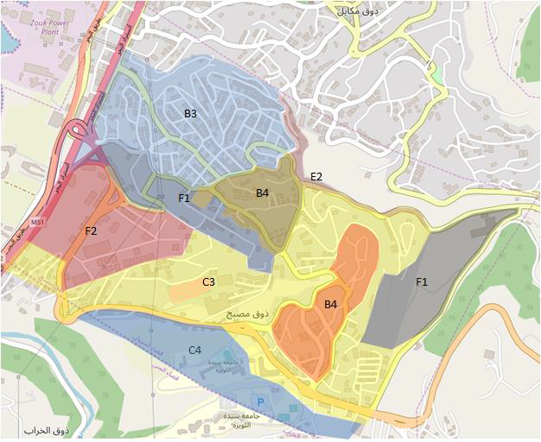
Case Study: Zouk Mosbeh Town Zoning plan
Residential
B3
C3
Industrial
F1
F2
B4
C4
E2
Figure 15: Zouk Mosbeh plan

Slide 13
Case Study: Zouk Mosbeh Town Limitations against pedestrian activities
Topography of Zouk Mosbeh
Absence of public transportation systems
Infrastructural congestion in the region

Slide 14
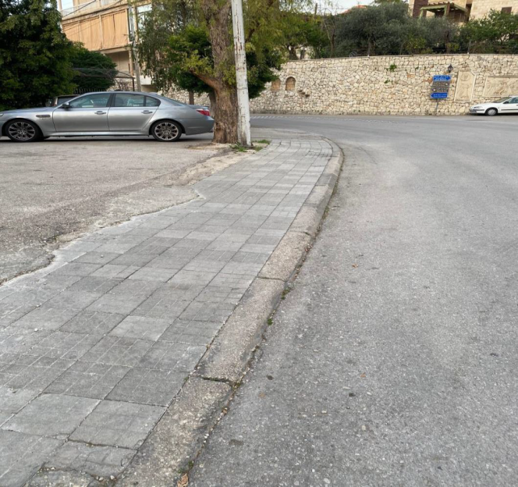
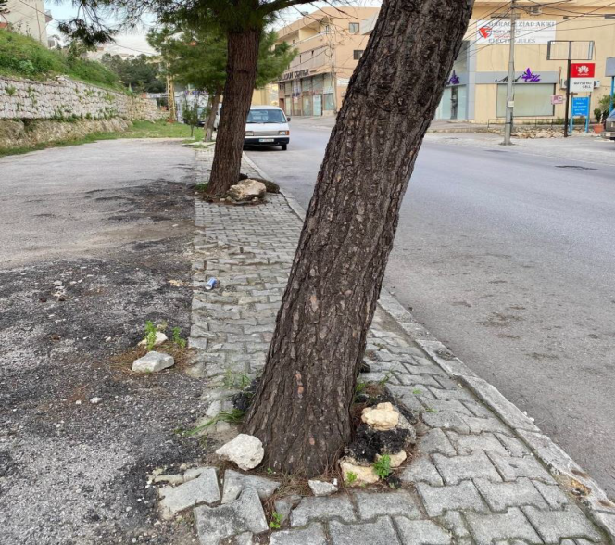
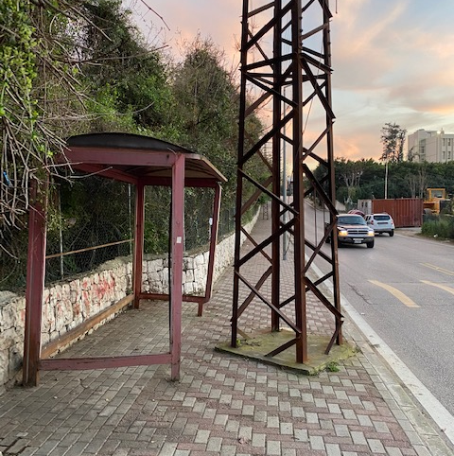
Streets Site Observations:
Figure 16: Sidewalk at the level of street
Figure 17: Trees interrupting pathway
Figure 18: Electric pole

Slide 15
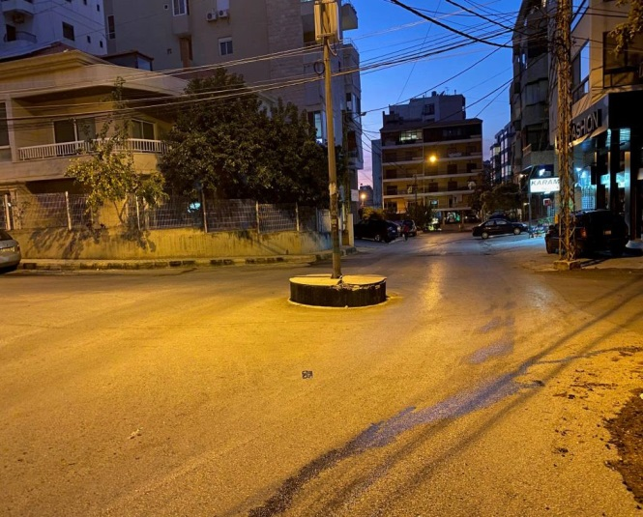
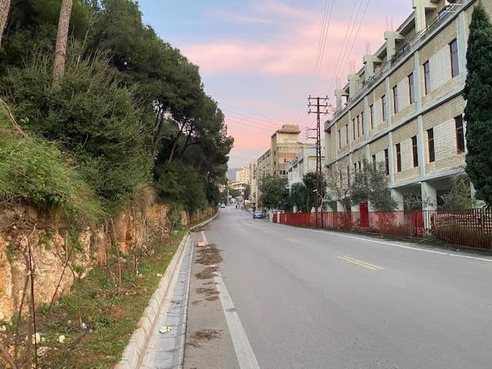
Streets Site Observations:
Figure 19: Traffic calming circle in street 1
Figure 20: Roundabout and islands
Figure 21: Street 14

Slide 16
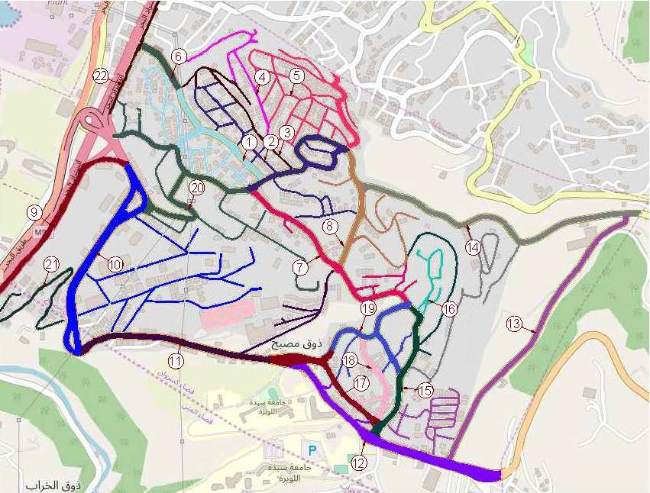
Streets Site Assessments:
Streets were divided into 22 sections:
Length range:
856 ft – 8,036 ft
Width range:
23 ft – 82 ft
Figure 22: Street numbering

Slide 17
Streets Site Assessments: Design components
- Sidewalk elements
- Pedestrian crossings
- Public surroundings
Complete streets
Figure 23: Design components

Slide 18
Streets Site Assessments: Design components
19 design elements were considered
Sidewalk elements
Presence of sidewalk
Sidewalk furniture
Pedestrian crossings
Crosswalks
Pavement striping
Public surroundings
Active storefronts
Active doors and windows
Driveway
Ramps
Landscape
Sidewalk lighting
Bollards
Crossing signage
Curb extensions
Refugee islands or medians
Outdoor seating
Shared parking space
On-street parking spaces
Public spaces(gardens-parks)

Slide 19
Streets Site Assessments: Methods for data analysis
Five-point scale rating system covering 19 design elements
Table 2: The rating system
Table 3: Street scores indications
Rating | Description
1 | elements that were not observed in any section of the street
2 | elements that were rarely observed
3 | elements that were sometimes observed
4 | elements that were observed most of the time
5 | elements that were always observed
Street score | Color indication
$$score ≤38$$ | Red
$$38<score≤57$$ | Orange
$$57<score≤76$$ | Yellow
$$76<score≤95$$ | Green

Slide 20
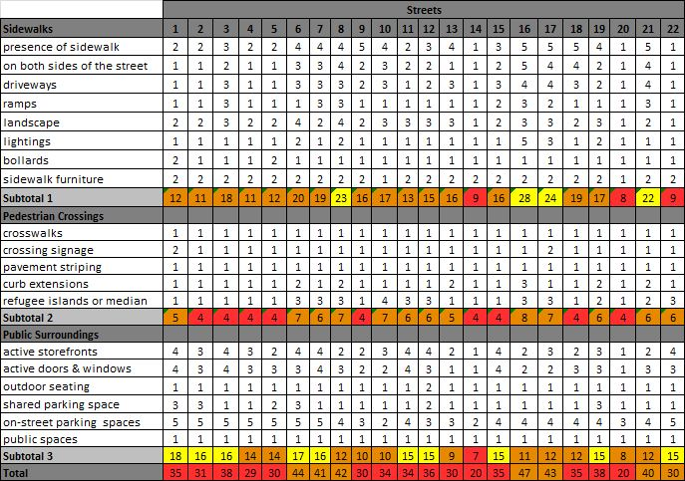
Street Site Assessments: Assessment scores
Table 4: Scoring system

Slide 21
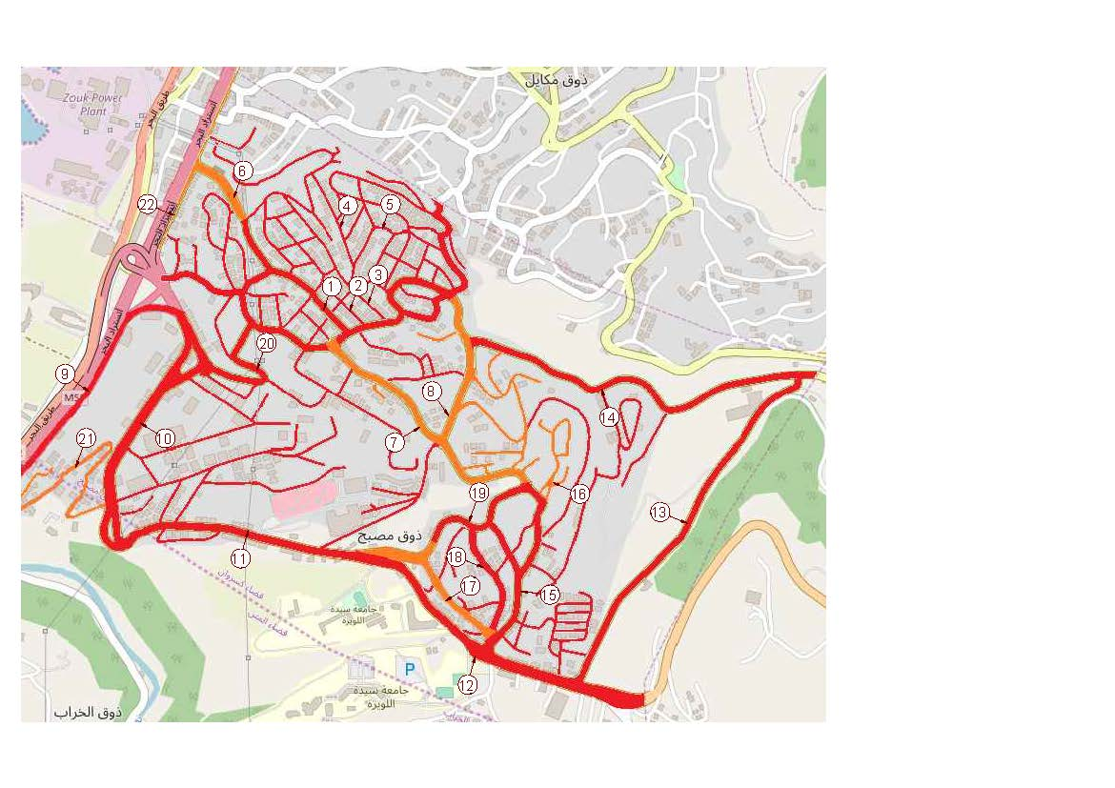
Street Site Assessments: Assessment scores
$$score ≤38$$
$$38<score≤57$$
$$57<score≤76$$
$$76<score≤95$$
Figure 24: Street score representation

Slide 22
Recommendations for Design Interventions:
Considerations taken into account:
Zoning of each street
Scoring system
Existing conditions for the ROW
Prevailing land-uses
Main priorities:
Building complete streets
Providing continuous pedestrian access

Slide 23
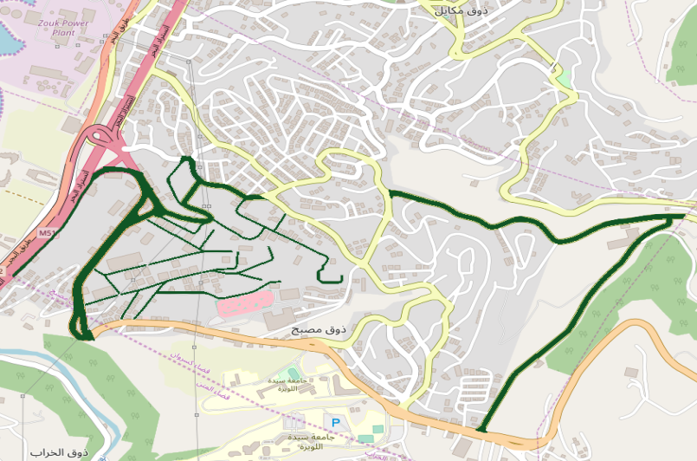
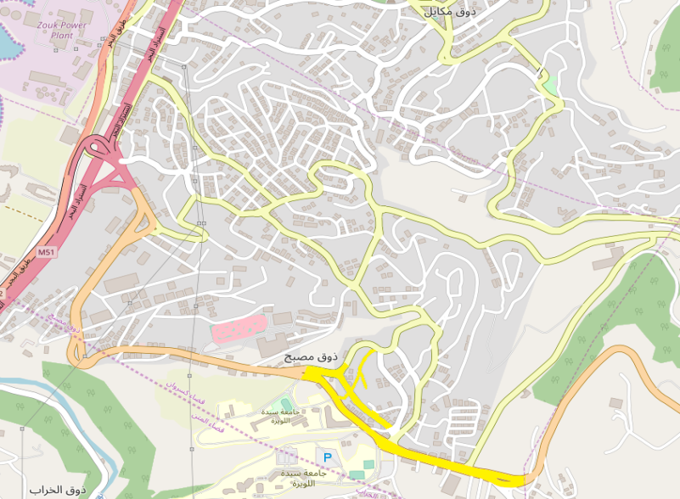
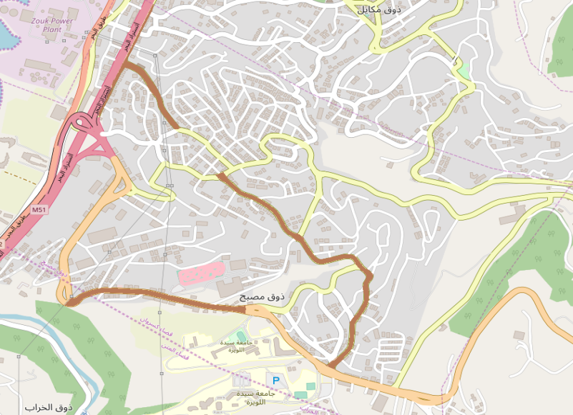
Recommendations for Design Interventions:
Residential
$$Industrial$$
$$Educational$$
Commercial
Figure 25: Street land-use

Slide 24
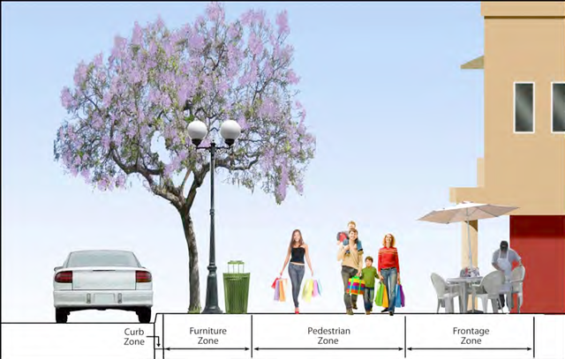
Recommendations for Design Interventions:
Table 5: Sidewalk widths
Land use | Total sidewalk width | Curb zone | Furnishing zone | Throughway zone | Frontage zone
Residential | 11’6’’ | 6’’ | 6’ | 5’ | 0
Educational, residential, and commercial | 13’ | 1’6’’ | 5’ | 5’ | 1’6’’
Industrial | 6’ | 0 | 0 | 0 | 0
Figure 26: Sidewalk zones

Slide 25
Recommendations for Design Interventions:
Recommendations for all streets
Illuminating the sidewalks and placing bollards for safety
Recommendations for commercial and educational streets
Placing elevated crosswalks
Marking the crosswalks and striping the pavement
Placing trees, benches, and signage
Placing handrails for the regions that have a slope exceeding 5%

Slide 26
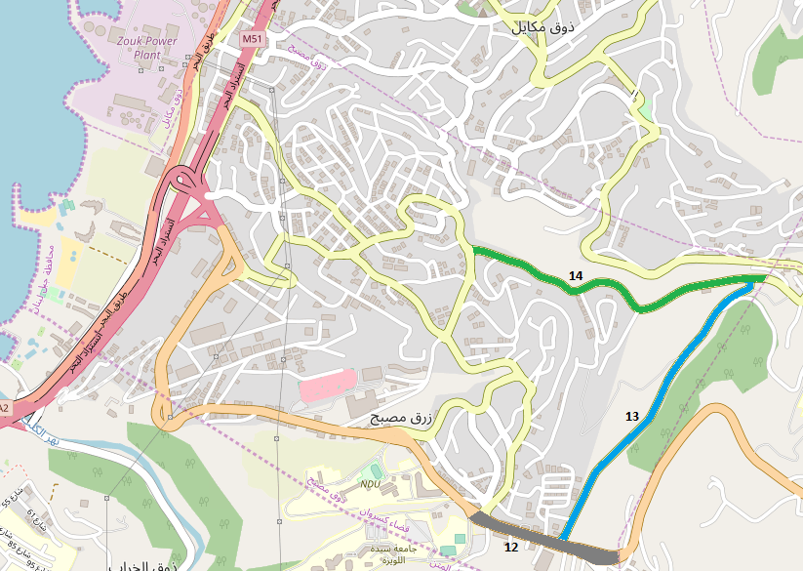
Recommendations for Design Interventions:
Figure 27: Streets 12, 13, and 14
Specific recommendations
Reducing the median width in street 12 to enlarge the sidewalk width
Shifting streets 13 and 14 to residential since the presence of buildings outweighs the presence industries there

Slide 27
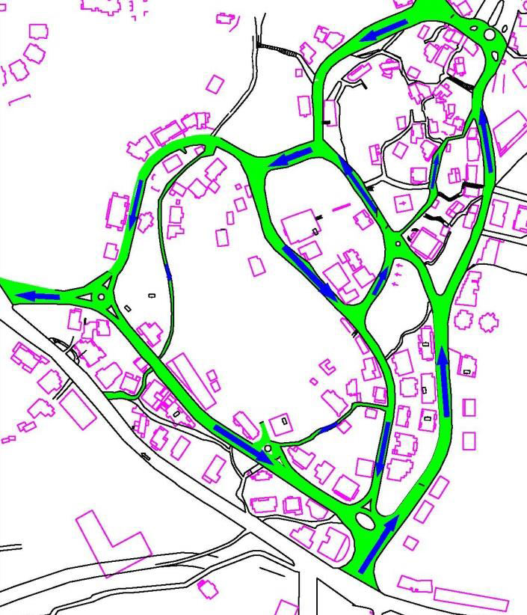
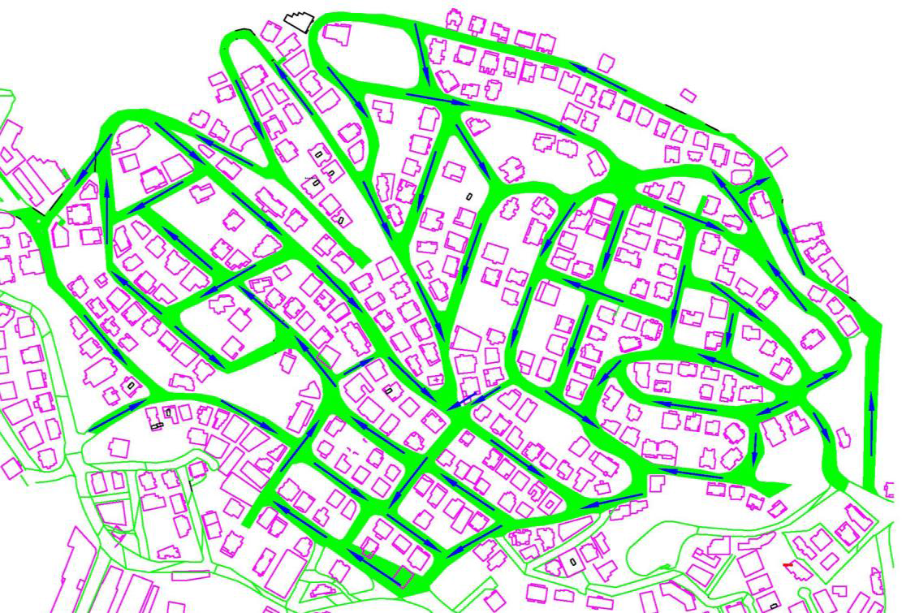
Recommendations for Design Interventions:
Rendering some streets one-way
Delay: 0-2 minutes
Circulation 1: streets 15, 17, 18, and 19
Circulation 2: streets 1, 2, 3, 4, and 5
Figure 28: One-way circulation 1
Figure 29: One-way circulation 2

Slide 28
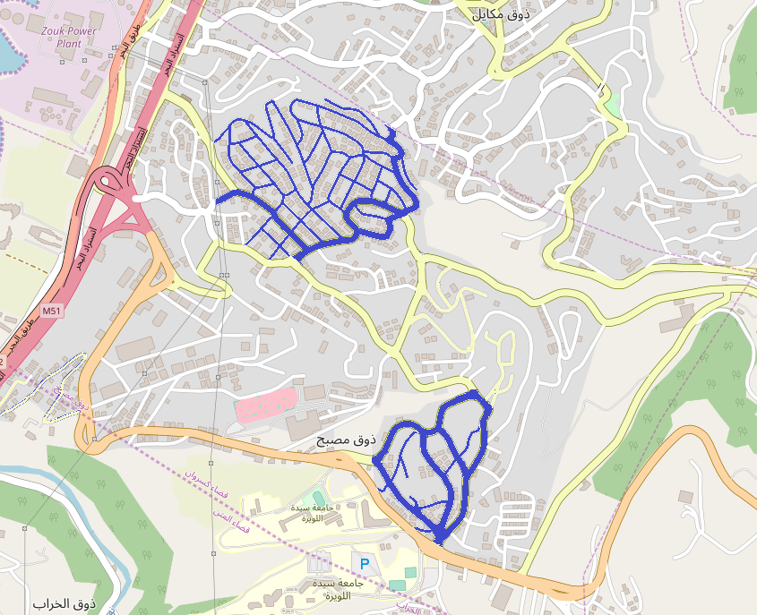
Recommendations for Design Interventions:
One-way circulations
Figure 30: One-way circulations

Slide 29
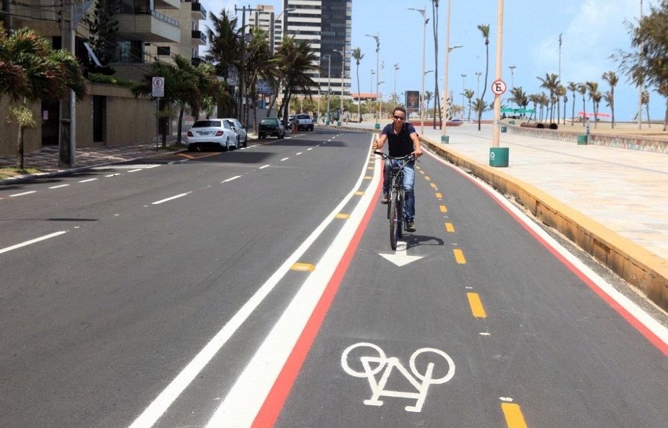
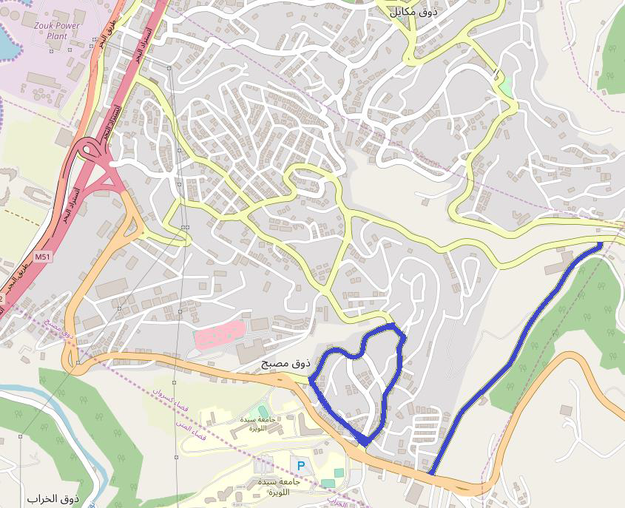
Recommendations for Design Interventions:
Adding cyclic lanes to streets 13,15, 17, and 19
Figure 31: Sample cyclic lane
Figure 32: Streets with cyclic lanes

Slide 30
Conclusion:
Expectations
Short-term:
- Residents might be disturbed by the streets’ modification
- The municipality might find this project costly
Long-term:
- Residents will adapt to the new modes of transportation
- Economic benefits will be added to this city after rendering it pedestrian-friendly

Slide 31
References:
Bödeker, M. (2018). Walking and Walkability in Pre-Set and Self-Defined Neighborhoods: A Mental Mapping Study in Older Adults. International Journal of Environmental Research and Public Health, 1-12.
Boodlal, L. (n.d.). Accessible Sidewalks and Street Crossings. Retrieved February 3, 2020, from https://nacto.org/docs/usdg/accessible_sidewalks_and_street_crossings_boodlal.pdf
Bushell, M. A., Poole, B. W., Zegeer, C. V., & Rodriguez, D. A. (2013, October). Costs for pedestrian and bicyclist infrastructure improvement. Retrieved April 2020, from http://www.pedbikeinfo.org/cms/downloads/Countermeasure%20Costs_Report_Nov2013.pdf
Bushell, M. A., Poole, B. W., Zegeer, C. V., & Rodriguez, D. A. (2013, October). Costs for Pedestrian and Bicyclist Infrastructure Improvements. Retrieved April 2020, from http://www.pedbikeinfo.org/cms/downloads/Countermeasure%20Costs_Report_Nov2013.pdf
Clifton, K. J. (2006, June 22). The development and testing of an audit for the pedestrian environment. Retrieved February 26, 2020, from PEDS-Pedestrian Environment Data Scan: http://kellyjclifton.com/peds/
(1998). Creating Walkable Communities. Washington: Bicycle Federation of America Campaign to Make America Walkable.
Dannenberg, A. L. (2017). Special Issue Editorial: Tools and practices for understanding and promoting walking and walkability. Journal of transport & health, 1-4.
Davis, T. c. (n.d.). History of the city. Retrieved from The city of Davis: https://www.cityofdavis.org/about-davis/history-symbols/first-bicycle-lanes-in-davis
Edwards, K. (2016). Step It up! Action Institute for Increasing Walking and Walkability. Journal of transport & health, S12-S13.
Ewing, R. (n.d.). Pedestrian and Transit-Friendly Design: A Primer for Smart Growth.
(2013). Fixed-Route Transit and Pedestrian Accessibility Study. Lawrence & Douglas County.
Galston, R. (2017). Places for People. Retrieved January 29, 2020, from https://mspace.lib.umanitoba.ca/xmlui/bitstream/handle/1993/32572/Galston%20CP%20Practicum%20REVISED%2009122017.pdf?sequence=1&isAllowed=y
Jacobs, J. (1992). The Death and Life of Great American Cities.
Khoury, N. E., Aboujaoudé, L. K., & Kadehjian, K. (2016). Road Transport Sector and Air Pollution. IPT Energy Center (IPTEC).
Laker, L. (2018, september). Walking the city. Retrieved from The Guardian: https://www.theguardian.com/cities/2018/sep/19/what-would-a-truly-walkable-city-look-like
Laplante, & McCann. (2008).
Moudon, A., Lee, C., Cheadle, A., Garvin, C., Johnson, D., Schmid, T., . . . Lin, L. (2006). Operational Definitions of Walkable Neighborhood: Theoretical and Empirical Insights. Journal of physical activity & health.
Natapov, A., & Greenberg, E. (2019). A physical effort-based model for pedestrian movement in topographic urban environments. Journal of Ubran Design, 86-107.
Ntziachristos, L., & Samaras, Z. (2019). EMEP/EEA air pollution emission inventory guidebook . European Environment Agency.
Ntziachristos, L., & Zissis Samaras. (2019). EMEP/EEA air pollution inventory guidebook. European Environment Agency.
Ozola, E. (2015). Architect's hands: how can we design better streets. TEDx. TEDx. Retrieved from https://www.youtube.com/watch?v=8iQnrM3DkVI
Panagopoulos, T., Tampakis, S., Karanikola, P., Karipidou-Kanari, A., & Kantartzis, A. (2018). The Usage and Perception of Pedestrian and Cycling Streets on Residents’ Well-being in Kalamaria, Greece.
Pedestrian-friendly streets. (2013). Retrieved March 2, 2020, from https://hidot.hawaii.gov/highways/files/2013/07/Pedest-Tbox-Toolbox_2-Pedestrian-Friendly-Streets.pdf
Planning and Designing for Pedestrians. (2002, June). Retrieved January 17, 2020, from https://www.sandag.org/uploads/publicationid/publicationid_713_3269.pdf
Ramps and curb ramps. (n.d.). Retrieved March 2, 2020, from United States Access Board: https://www.access-board.gov/guidelines-and-standards/buildings-and-sites/about-the-ada-standards/guide-to-the-ada-standards/chapter-4-ramps-and-curb-ramps
(n.d.). Reclaiming city streets for people chaos or quality of life? European Commission.
Roberts, D. (2017, april 22). A fascinating new scheme to create walkable public spaces in Barcelona. Vox.
Sadik-Khan, J. (2018, september). Why protected bike lanes are more valuable than parking spaces. (C. Waiters, Interviewer)
Santos, P. M., & Tanscheit, P. (2017, August 8). Building Better Cities for Pedestrians Means Connecting the 'Last Mile'. Retrieved from TheCityFix: https://thecityfix.com/blog/building-better-cities-for-pedestrians-means-connecting-the-last-mile-paula-santos-paula-tanscheit/
Smart Growth America. (n.d.). Retrieved January 31, 2020, from https://smartgrowthamerica.org/program/national-complete-streets-coalition/publications/what-are-complete-streets/
Stefanucci, J., Proffitt, D., & Banton, T. (2005). Distances appear different on hills. Perception & Psychophysics.
Tight, M., Kelly, C., Hodgson, F., & Page, M. (2004). IMPROVING PEDESTRIAN ACCESSIBILITY AND QUALITY OF LIFE. 10th World Conference on Transport Research. Istanbul.
Urban Street Design Guide. (n.d.). Retrieved February 3, 2020, from National Association of City Transportation Officials: https://nacto.org/publication/urban-street-design-guide/streets/residential-shared-street/

